Slide 1
Getting Started With IPv6
Walter Horowitz
Mardovar Networking LLC
walter@mardovar.com

Slide 2
We Need IPv6
Exponential growth of the Internet and the exhaustion of the IPv4 address space IANA's exhaustion on January 31 2011, APNIC's exhaustion on April 15 2011
Growth of the Internet and the ability of Internet backbone routers to maintain large routing tables
Need for simpler configuration
Requirement for security at the IP level
Need for better support for real-time delivery of data—also called quality of service (QoS)
New services may be IPv6 only, some already are
Federal Government has mandated the use of IPv6

Slide 3
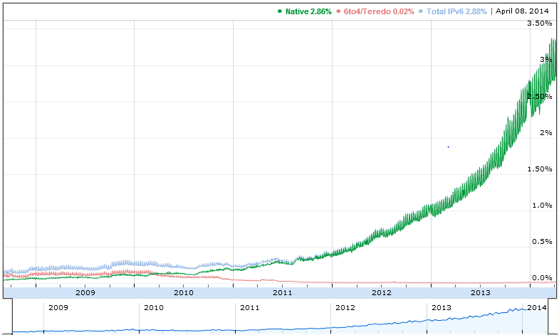
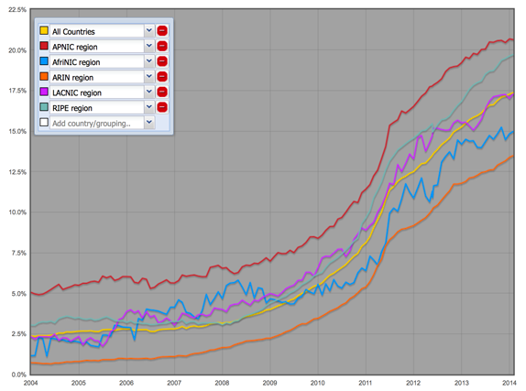
IPv6 is now alive on the Internet
April 2011 - World IPv6 Test
June 6, 2012 - IPv6 World Launch
percentage of IPv6-enabled Autonomous Systems
IPv6 connectivity to Google

Slide 4
Major Services In IPv6
> www.google.com
Server: google-public-dns-a.google.com
Address: 8.8.8.8
Non-authoritative answer:
www.google.com internet address = 74.125.226.52
www.google.com internet address = 74.125.226.49
www.google.com internet address = 74.125.226.50
www.google.com internet address = 74.125.226.51
www.google.com internet address = 74.125.226.48
www.google.com AAAA IPv6 address = 2607:f8b0:4006:807::1011

Slide 5
Are You Using IPv6?

Slide 6
Are You Using IPv6?
Option in Windows XP, Linux since 2.1.8
Standard in Vista+, Linux 2.5.x and 2.6.x kernel
MacOS X, Linux, BSD all prefer IPv6
Lion uses Happy Eyeballs (use fastest response)
Windows HomeGroup breaks if you disable IPv6
DirectAccess and Remote Assistance require IPv6
Your devices may be IPv6 ready
https://www.ipv6ready.org/

Slide 7
Differences Between IPv4 & IPv6
Feature IPv4 IPv6
Address length 32 bits 128 bits
IPSec support Optional Required
QoS support Some Better
Fragmentation Hosts and routers Hosts only
Packet size 576 bytes 1280 bytes
Checksum in header Yes No
Options in header Yes No
Link-layer address resolution ARP (broadcast) Multicast Neighbor Discovery Message
Multicast membership IGMP Multicast Listener Discovery (MLD)
Router Discovery Optional Required
Uses broadcasts Yes No
Configuration Manual, DHCP Automatic, DHCP
DNS name queries Uses A records Uses AAAA records
DNS reverse queries Uses IN-ADDR.ARPA Uses IP6.arpa

Slide 8
IPv6 Address Format
IPv6 address in binary form:
0010000000000001110110111000001100000000000000000010111100111011
0000001010101010000000001111111111111110001010001001110001011010
Divided along 16-bit boundaries:
0010000000000001 1101101110000011 0000000000000000 0010111100111011
0000001010101010 0000000011111111 1111111000101000 1001110001011010
Each 16-bit block is converted to hexadecimal and delimited with colons:
2001:DB83:0000:2F3B:02AA:00FF:FE28:9C5A
Suppress leading zeros within each 16-bit block:
2001:DB83:0:2F3B:2AA:FF:FE28:9C5A

Slide 9
Compress One Block of Zeros
Some IPv6 addresses contain long sequences of zeros
A single contiguous sequence of 16-bit blocks set to 0 can be compressed to “::” (double-colon)
Example:
FE80:0:0:0:2AA:FF:FE9A:4CA2 becomes FE80::2AA:FF:FE9A:4CA2
FF02:0:0:0:0:0:0:2 becomes FF02::2
Cannot use zero compression to include part of a 16-bit block
FF02:30:0:0:0:0:0:5 does not become FF02:3::5

Slide 10
Key Address Prefixes
Prefix | Allocation | Example
2000::/3 to 3fff | Global Unicast | 2002:AB::16/64
2001::DB8::/32 to 2001:DB8:FFFF | Documentation Prefix | 2001:DB8:AA::/64
FC00::/7 to FDFE | Unique Local Unicast | FC00:AB::7/64
FE80::/10 to FEBF | Link Local Unicast | FE80::6AEF:BDFF:FE61:4D13
FF00::/8 to FFFF | Multicast | FF01::1 – All nodes int’f FF02::2 – All routers on link FF05::2 – All routers at site
::FFFF/96 | IPv4 Mapped | Used to embed IPv4 addresses in an IPv6
::/128 is the unspecified address
::1/128 is the loopback address

Slide 11
Types of IPv6 Addresses
Unicast
Address of a single interface
One-to-one delivery to single interface
Multicast
Address of a set of interfaces
One-to-many delivery to all interfaces in the set
Anycast
Address of a set of interfaces
One-to-one-of-many delivery to the closest interface
No more broadcast addresses

Slide 12
Aggregatable Global Unicast Addresses
Top-Level Aggregation ID (TLA ID) /16
Next-Level Aggregation ID (NLA ID) /48 or /56
Site-Level Aggregation ID (SLA ID) /64
Interface ID (MAC derived?)
13 bits
8 bits
24 bits
16 bits
64 bits
001
TLA ID
Res
NLA ID
SLA ID
Interface ID

Slide 13
Link-Local Addresses
Format Prefix 1111 1110 10
FE80::/64 prefix
Used for local link only
Single subnet, no router
Address autoconfiguration
Neighbor Discovery
10 bits
54 bits
64 bits
1111 1110 10
000 . . . 000
Interface ID

Slide 14
IPv6 Addresses for a Host
Unicast addresses:
A link-local address for each interface
Unicast addresses for each interface (unique-local or global addresses)
A loopback address (::1)
Multicast addresses:
The node-local scope all-nodes multicast address (FF01::1)
The link-local scope all-nodes multicast address (FF02::1)
The solicited-node address for each unicast address
The multicast addresses of joined groups

Slide 15
IPv6 Interface Identifiers
The last 64 bits of unicast IPv6 addresses
Interface identifier based on:
Extended Unique Identifier (EUI)-64 address
Either assigned to a network adapter card or derived from IEEE 802 addresses
Temporarily assigned, randomly generated value that changes over time
A value assigned by a stateful address configuration protocol
A value assigned during a Point-to-Point Protocol connection establishment
A manually configured value

Slide 16
Conversion of an IEEE 802 Address to an EUI-64 Address
IEEE-administered company ID
Manufacturer-selected extension ID
24 bits
24 bits
ccccccug cccccccc cccccccc
xxxxxxxx xxxxxxxx xxxxxxxx
IEEE 802 Address
ccccccUg cccccccc cccccccc
11111111
11111110
xxxxxxxx xxxxxxxx xxxxxxxx
EUI-64 Address
0xFF
0xFE
Complement the universally/locally administered (U/L) bit

Slide 17
Plan for your IPv6 Move
Obtain an IPv6 Network Address
Enable Dual Stack in machines
Plan for your Network subnets
Enable IPv6 in Routers
Enable IPv6 in Services
DNS
DHCP
Mail

Slide 18
How to Get an IPv6 Address
Ask your ISP
You should get a /48 address block - 65,536 subnets
You can get a bigger block if necessary
Home users may get less /52 4096 subnets, /56 is 256
http://www.tunnelsup.com/subnet-calculator
Ask your Regional Internet Registry
For Multihoming sites only, multiple ISP
Test with a Tunnel Broker
Hurricane Electric
SixXs.net
gogo6.com

Slide 19
Plan Your Address Allocation
Expect significant growth for each subnet
Use a good tool
https://osl.uoregon.edu/redmine/projects/netdot
http://sourceforge.net/projects/haci/
Others
Get a manual
http://www.ripe.net/lir-services/training/material/IPv6-for-LIRs-Training-Course/Preparing-an-IPv6-Addressing-Plan.pdf

Slide 20
Transitional Technologies
6to4 – Not recommended
http://tools.ietf.org/html/draft-ietf-v6ops-6to4-to-historic-05
6over4
Requires IPV4 multicast – not worth your time
ISATAP
Uses DNS to find potential routers, Intra-Site only
Teredo
Tunnel IPv6 packets within UDP
Does your ISP support 6rd? (IPv4 tunnel)
NAT64/DNS64 – NAT only IP4 only sites
Dual Stack is Preferred
Code for “Happy Eyeballs”

Slide 21
Add IPv6 to a router
Cisco
ipv6 unicast-routing
Ipv6 cef
Interface x
Ip v6 address x/y (e.g. 2001:db8::2345.2345/126)
ipv6 route address/bits interface
ipv6 route ::/0 Serial2/0 (i.e. default route to Serial 2/0)
Tunnel if necessary
Insure you have correct Firewall rules

Slide 22
DNS and IPv6
Don’t give out IPv6 addresses if you can’t reach them.
AAAA records for IPv6 name to address resolution
IP6.arpa type PTR records for address lookup
http://www.zytrax.com/books/dns/ch3/#ipv6-calculator
Test for IPv6 capability
http://test-ipv6.com/
(Cox talks about having IPv6, Verizon started 2013)

Slide 23
DHCP and IPv6
Not required – stateless address assignment
Do you want to be able to trace problems back to a specific user? Windows 7+, Mac OSX 10.7+ use Privacy Extensions by default.
PE can be Enabled in Linux, default disabled in Ubuntu
net.ipv6.conf.eth0.use_tempaddr=2
Available in Windows Server 2008 R2 & Linux
Set DNS Recursive Name Server
Domain Search List

Slide 24
Linux and IPv6
HOWTO at
http://www.tldp.org/HOWTO/Linux+IPv6-HOWTO/
Is your kernel IPv6 ready?
test -f /proc/net/if_inet6 && echo "kernel is IPv6 ready“
modprobe ipv6
Commands
ping6 & traceroute6 (from iputils) eg. ping6 ff02::1

Slide 25
Free IPv6 Certification
https://ipv6.he.net/certification/
Prove that you have IPv6 connectivity
Prove that you have a working IPv6 web server
Prove that you have a working IPv6 email address
Prove that you have working forward IPv6 DNS
Prove that you have working reverse IPv6 DNS for your mail server
Prove that you have name servers with IPv6 addresses that can respond to queries via IPv6
Prove your knowledge of IPv6 technologies through quick and easy testing

