Slide 1
Getting to Massive Sensor Networks by Tenfold Steps
Orders of magnitude from mainframes to the IoT

Slide 2
Zigurd Mednieks
zigurd.com
surfaceable.com
http://amzn.com/dp/1118183495
http://amzn.com/dp/1449316646
Or just google “zigurd”
zigurd.mednieks@gmail.com
617 500 7369

Slide 3
Books
Enterprise Android
Programming Android
The upcoming Deep Dive series for Addison Wesley, as series editor
The Mobile Sensing Enterprise for APress
Contact me re early access and if you want to be an author: zigurd.mednieks@gmail.com

Slide 4
What is this story about?
Knowledge workers and their environment
Discontent and change
Orders of magnitude
How the established order is overturned
How that will play out in the coming age of sensor networks

Slide 5
Android Deep Dive
Embedded Programming with Android: Bringing Up an Android System from Scratch (Android Deep Dive)
Roger Ye

Slide 6
Knowledge workers
Knowledge workers have been around (unlike factory workers) forever
Tallying and reckoning has been around for about 50,000 years
Offices have been around for about 500 years

Slide 7
Knowledge workers drive information management progress
Mainframe computing
Report generation
Getting information to knowledge workers

Slide 8
The first industry dominance
IBM used to be 80%+ of the computing industry
The Information Management System (IMS), created for the Apollo space program dominated software
This was before computing got exposed to a mass-market

Slide 9
IBM mainframes, IMS, and knowledge workers
Knowledge workers depend on information in IMS
Information is delivered in the form of reports
Knowledge workers specify the reports they need, IT personnel program them… someday

Slide 10
Knowledge workers are malcontents
Reports are hard to specify
Implementation backlogs threaten the relevance of reports
Iteration is difficult or impossible
IT is seen as a roadblock, not an enabler

Slide 11
Bob? You know how this story goes
Steve and Steve made a usable “personal” computer
Bob wrote a tool that enables individuals to crunch numbers and make their own analyses and reports
But, then...

Slide 12
But, then...
IBM put their product development process aside
The IBM PC matched Apple for price, and was a little more capable
Jon and Mitch wrote a very similar tool for knowledge workers

Slide 13
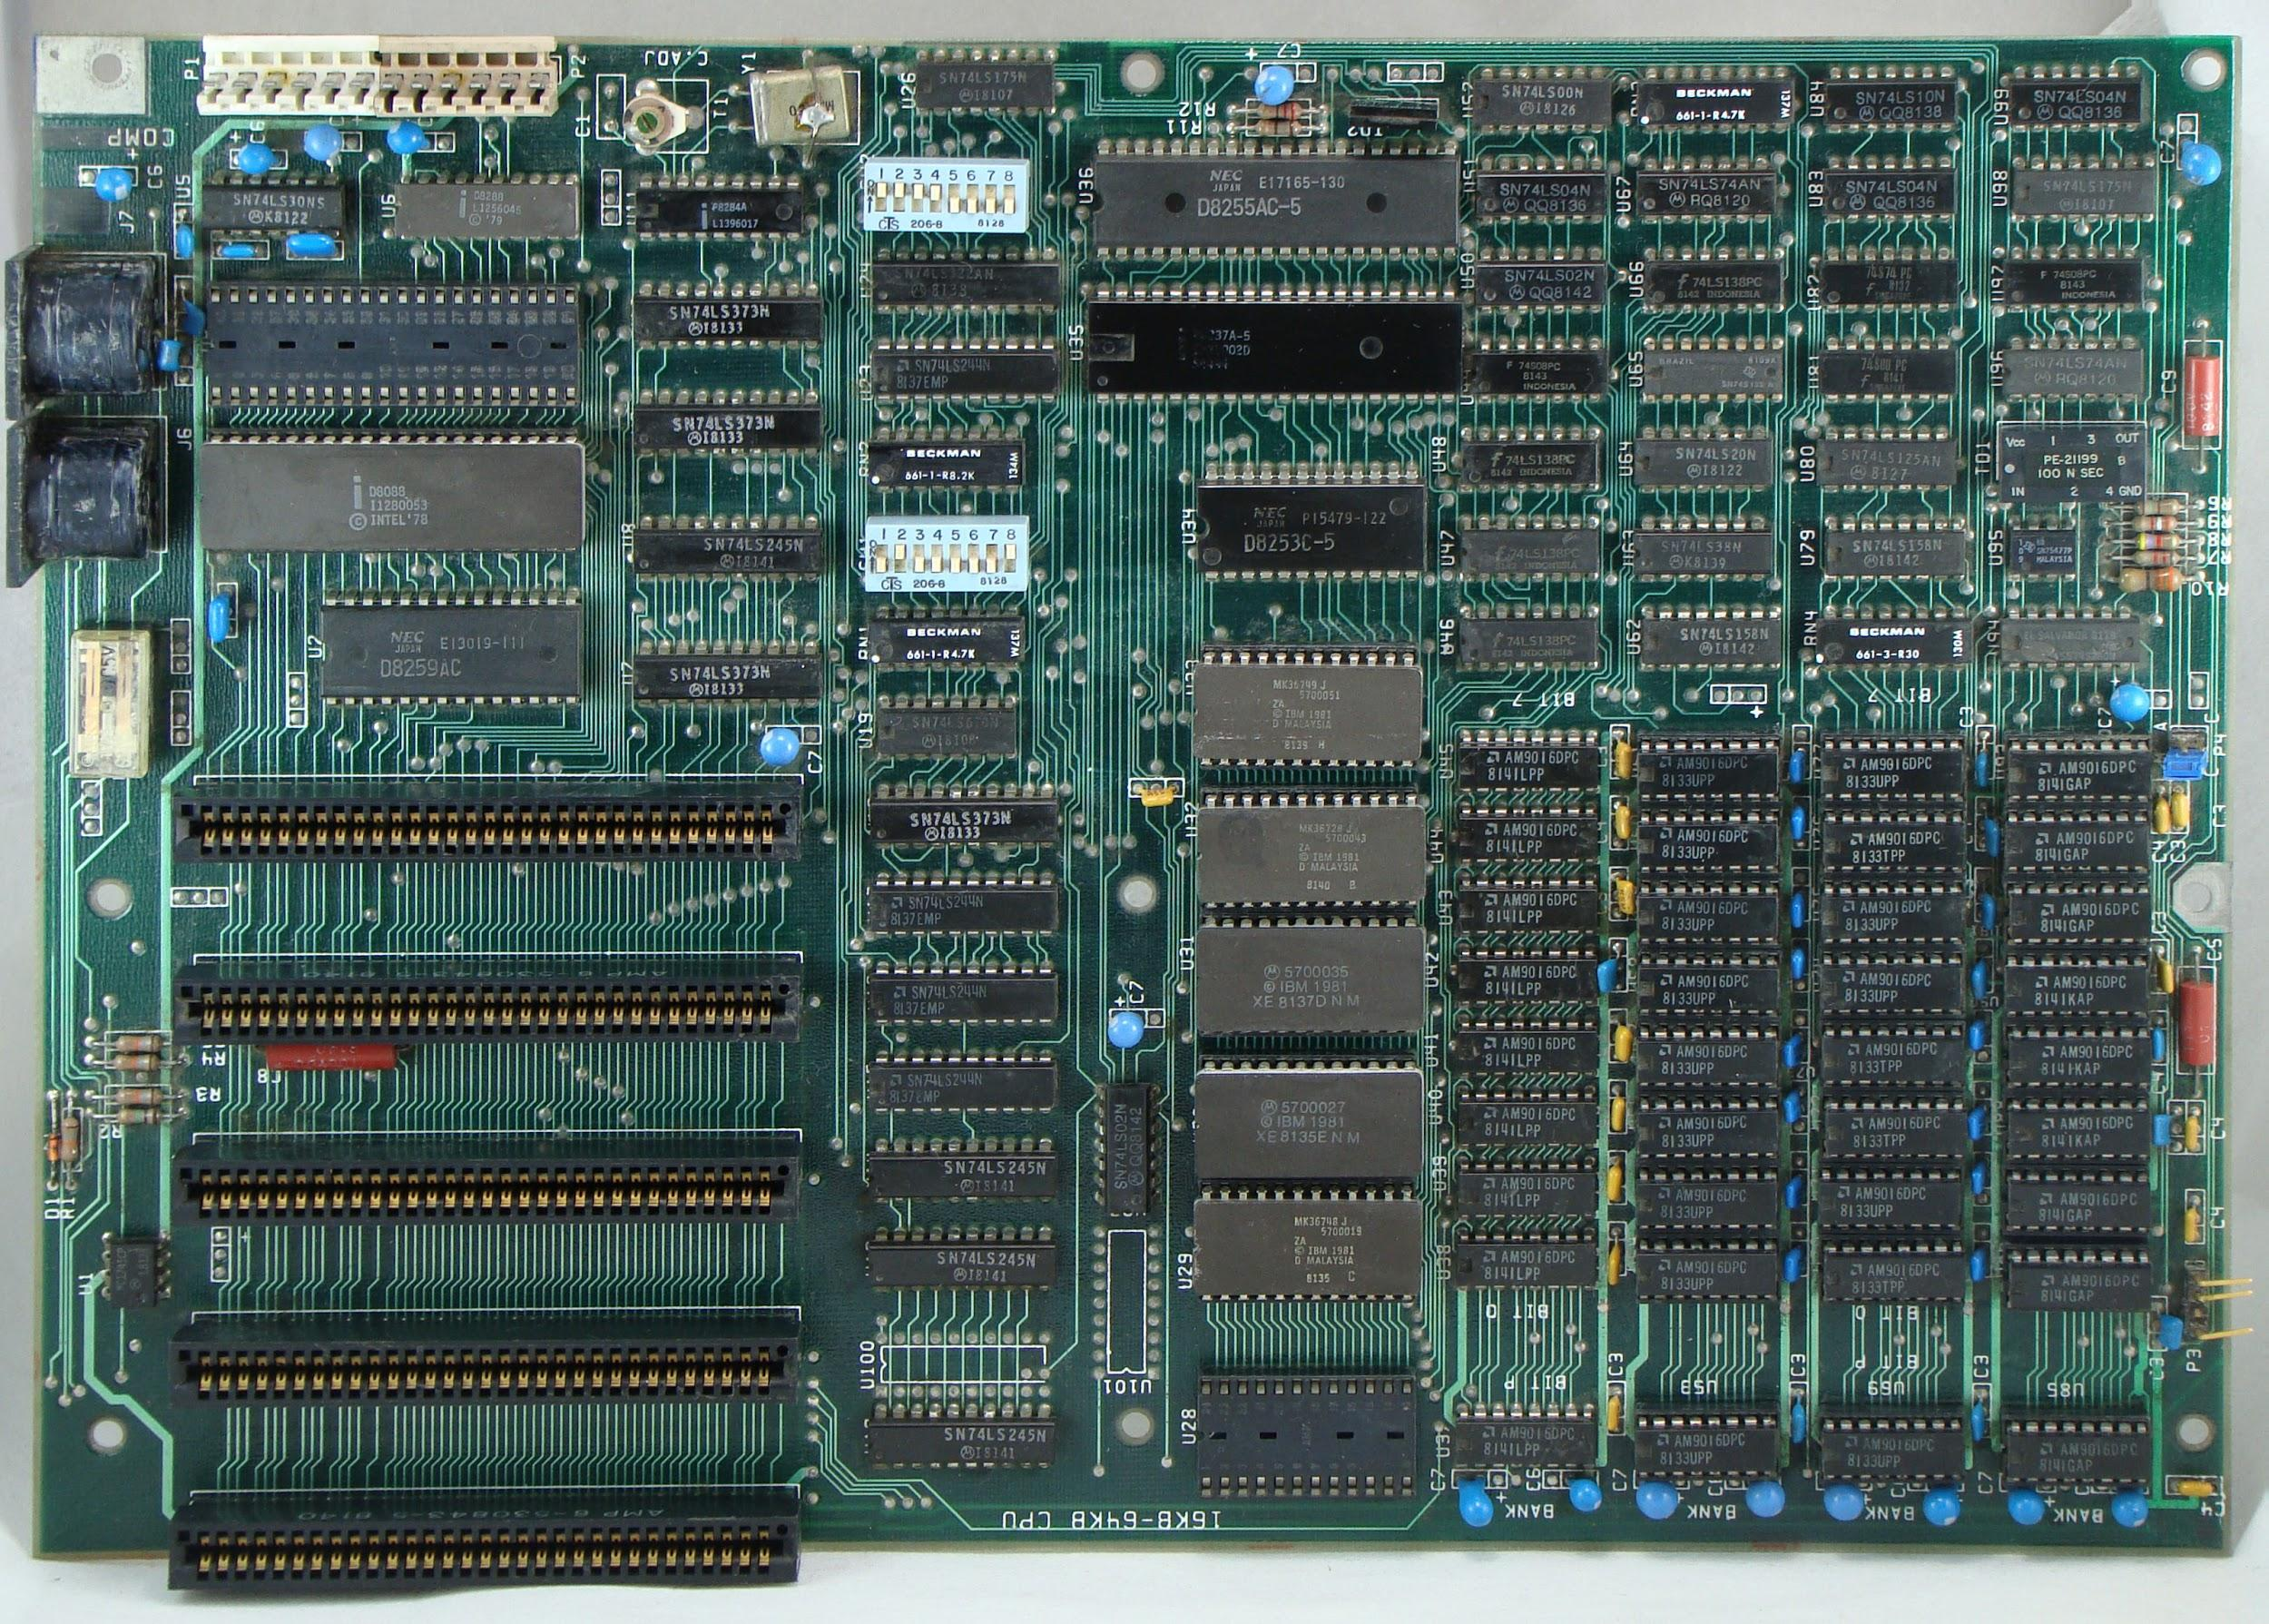

Slide 14
After that, everything looked like a PC
PC processors became the fastest processors
PC GPUs became the fastest GPUs
Large storage became arrays of PC-sized disks
Data centers are full of many PC-architecture servers

Slide 15
Does that make sense?
How likely is it that the optimal CPU is a Core i7 or Xeon?
...that the optimal storage unit is 3.5 inches?
...that the best graphics performance is from an array of PC GPU cores?

Slide 16
For example:
8086: 29,000 transistors
ARM1: 25,000 transistors
And yet, ARM could make no dent in the PC industry

Slide 17
IBM had their own RISC SPU
Wasn’t quite ready for the PC
Eventually became Power PC
Never caught up

Slide 18
Orders of magnitude
Mainframes numbered in the tens of thousands, at their peak, and still number in the low to middle tens of thousands worldwide

Slide 19
Orders of magnitude
PCs very quickly went from 100s of thousands of unit to millions
The mature PC market is measured in the hundreds of millions of units

Slide 20
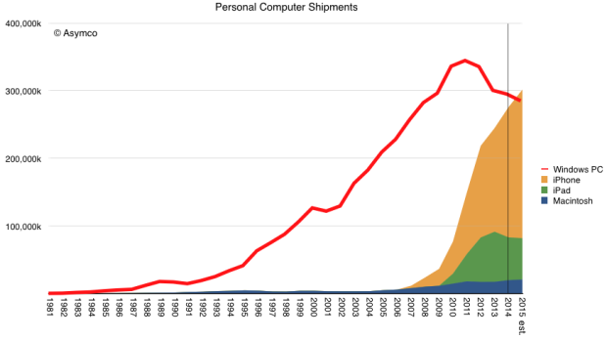
Ramps up to millions of units, quickly

Slide 21
Ruh roh! What happened here?

Slide 22
Outspending the rest of the industry, by an order of magnitude
A mass market supports unprecedented R&D spending levels
Not just processor R&D, but production process spending: More than $10 billion in annual capex

Slide 23
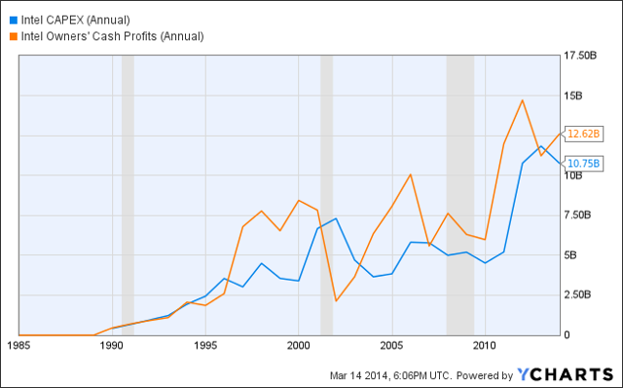

Slide 24
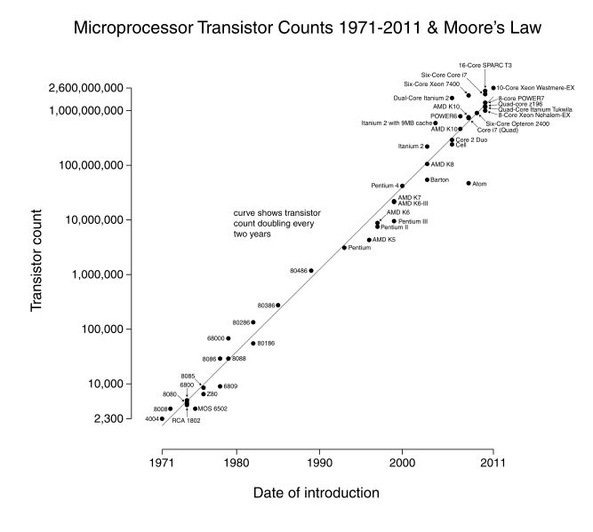

Slide 25
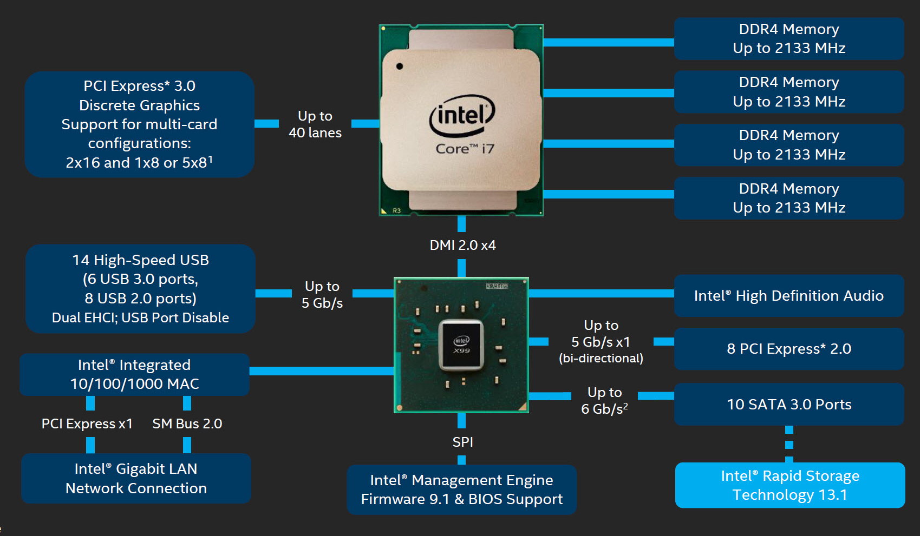

Slide 26
What do you get for all that money?
Billions of transistors
That gets you the ability to make deeper pipelines, bigger caches, etc.
It also gets you smaller dimensions
Smaller dimensions means you can do these things with less cost and less power

Slide 27
How do you break a dominance this strong?
Apple, again
Apple wanted a tablet computer
They wanted it to have a long battery life
Untethered, natural computing everywhere

Slide 28
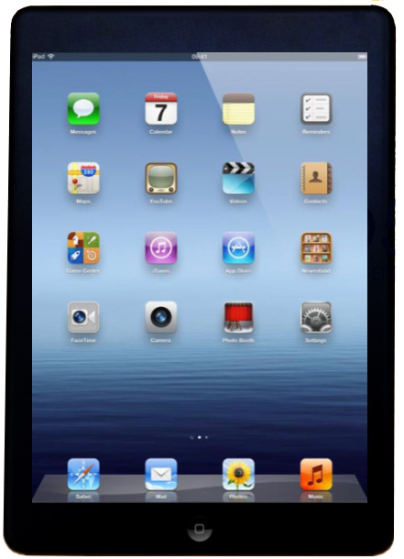

Slide 29
Not that one

Slide 30
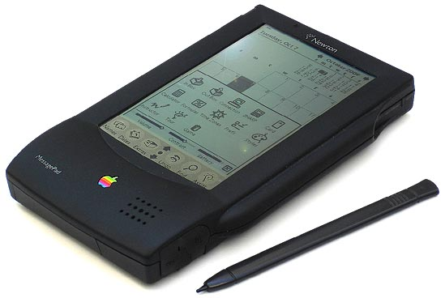
This one

Slide 32
And then came Nokia
The first phone that was more than an implementation of theITU standard
Apps: Calculator, clock, calendar, currency converter, snake game
Better SMS UX
Needs a CPU!

Slide 33
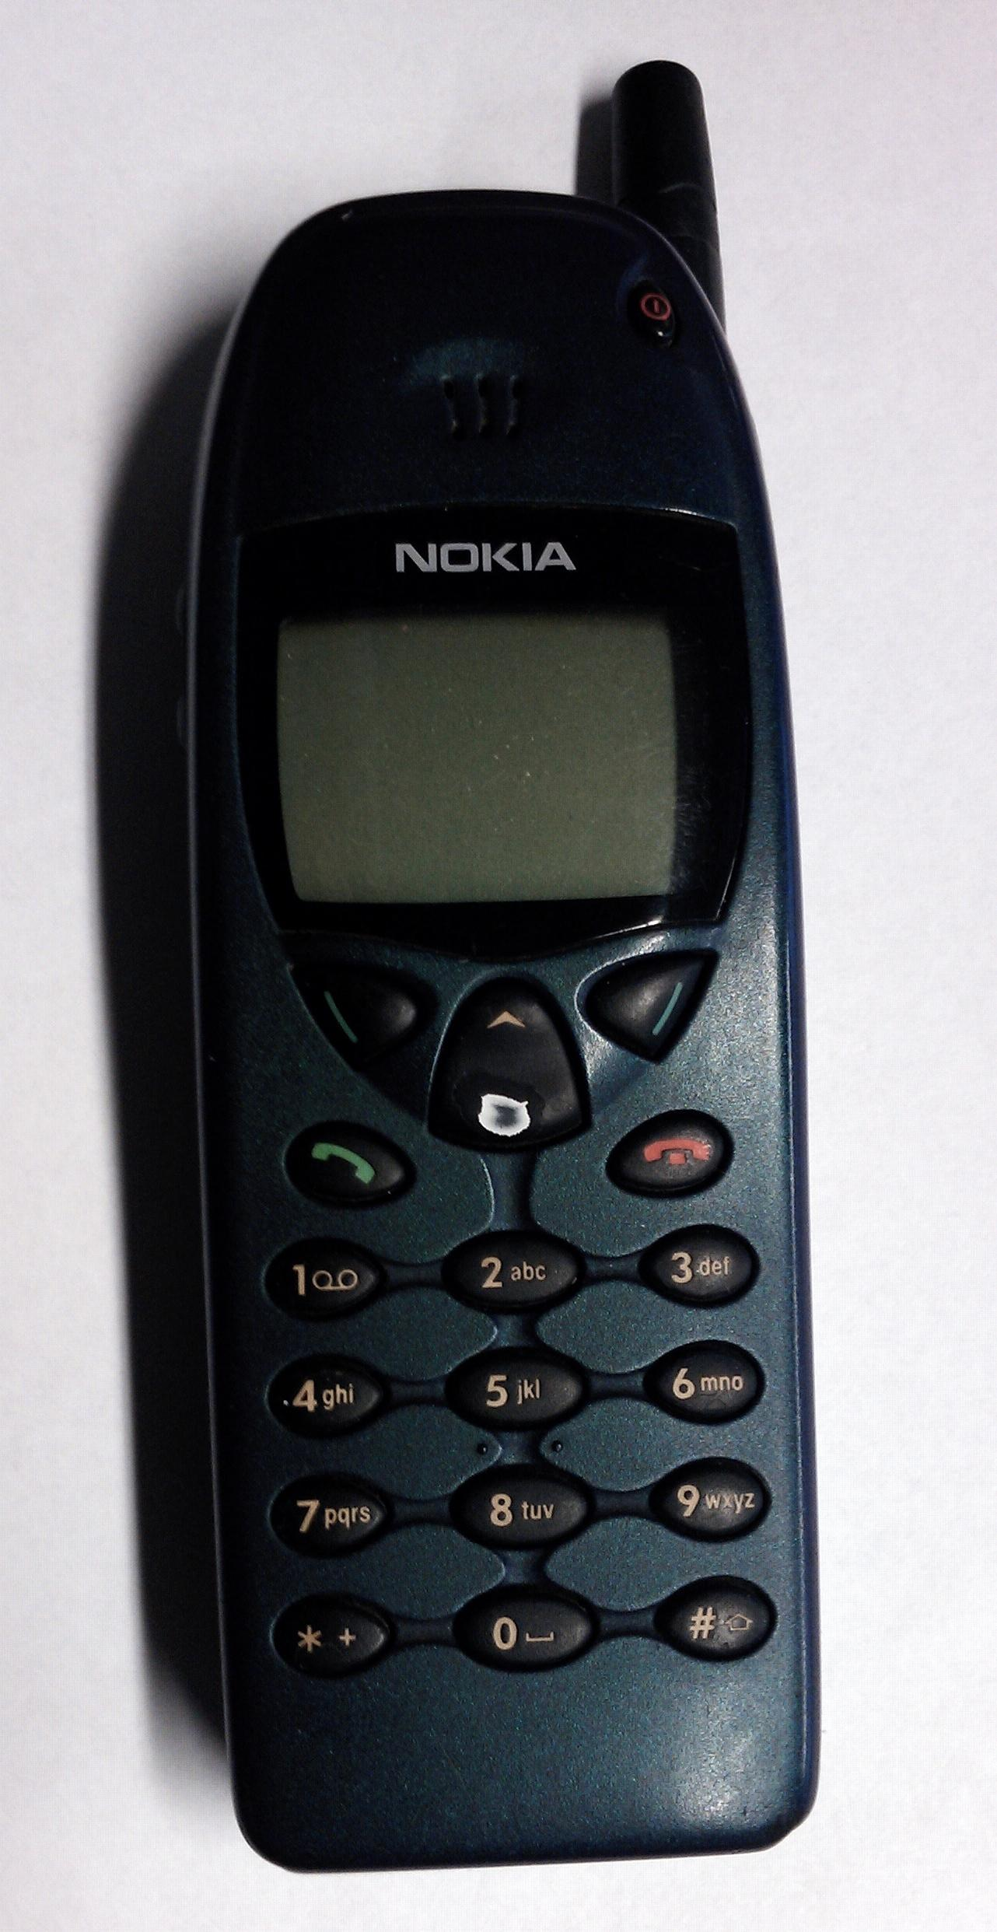
"Nokia 6110" by Trogain - Own work. Licensed under CC BY-SA 3.0 via Wikimedia Commons - http://commons.wikimedia.org/wiki/File:Nokia_6110.jpg#/media/File:Nokia_6110.jpg

Slide 34
How do you break a dominance this strong?
And you need knowledge workers
They want mobile devices now
They want to get information anywhere, anytime
In parts of the world, knowledge workers never used a PC, they can skip over the PC

Slide 35
Billions and billions
PCs topped out at around 400 million units and are in decline, currently about 300 million units
Why? They no longer dominate manufacturing economics
PCs were used by many people who did not need them because they were the least expensive way to access information

Slide 36
Mobile dominance
People are choosing mobile devices
Mobile device component economics has broken the stranglehold of PC economics
Mobile shifted the emphasis to power efficiency
ARM’s business model steered around Intel’s unassailable fortress: Intel’s fabs

Slide 37
Imaging
Imaging has been driven by its role in smart mobile device
Like GPUs and storage, the center pf gravity in imaging is moving toward mass-market devices
Prediction: High-end cameras will become arrays of devices, photography will become computational

Slide 38
What’s after mobile?
IoT will drive unit volumes in the 10s of billions
Different peripherals will be SoC integrated
Different applications
ARM will carry their advantage in power management into IoT

Slide 39
The future is here...
...just not evenly distributed
Near 20 billion ARM CPUs annually in embedded processors, compared to a little under 2 billion in mobile devices

Slide 40
Different peripherals
Proximity sensors
Temperature
Barometric pressure sensors
Position sensors
Magnetic field sensors
Acceleration sensors
Microphones
Magnetometers
Flow sensors
Pressure sensors

Slide 41
Sensors ride the wave of billions of units
Like CPUs and storage for PCs…
Like cameras for mobile phones…
Sensors will become inexpensive, small, and highly capable
Some of this already happened for mobile devices
Application ideas will come from looking ahead down the price curve for sensors

Slide 42
Who will drive adoption
Knowledge workers
They wanted to do their own analysis
They wanted to be mobile
The apps that will drive IoT adoption will be compelling to knowledge workers

Slide 43
Instant information
From sensors, to storage, to analysis, to Web scripting, to presentation

Slide 44
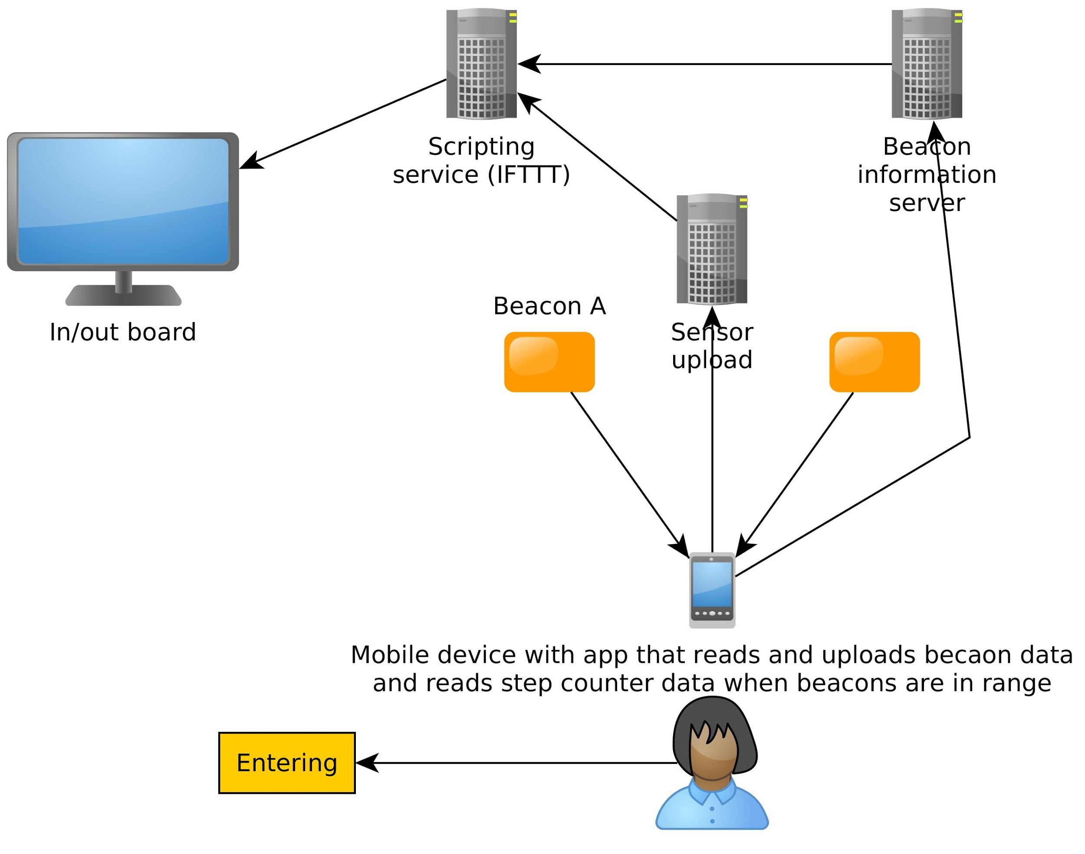

Slide 45
I want to hear from you
Radio experts
Sensor experts
SoC architects

