Slide 1
restic: Backups done right
Brian DeLacey, BLU @ MIT
February 15, 2017

Slide 2
About Brian …
Brian worked for a number of years at Lotus Development and IBM in different roles within the development community. He’s also worked in the research area at Harvard Business School.
Brian was an early adopter of the Mac, past Executive Director of the Macintosh User Group, and long-time member of the Boston Computer Society.
Brian has worked on mainframes, minis, micros, PCs, and IoT Devices in a variety of languages, across a number of operating systems.
Brian’s recent activities involve Go and network-ware.

Slide 3
Welcome to restic

Slide 4
What do users want?
Users don’t want to do backups.
Users want to do restores!

Slide 5
restic Design Principles
Easy
Fast
Verifiable
Secure
Efficient
Free
Notes:
https://github.com/restic/restic/blob/master/doc/index.md

Slide 6
Security Threat Model
The design goals for restic include being able to securely store backups in a location that is not completely trusted, e.g. a shared system where others can potentially access the files or (in the case of the system administrator) even modify or delete them. General assumptions: The host system a backup is created on is trusted. This is the most basic requirement, and essential for creating trustworthy backups.
Source: https://restic.readthedocs.io/en/stable/Design/

Slide 7
restic Highlights - "Backups done right!"
Restic is licensed under "BSD 2-Clause License".
Open source written in Go
Latest Version as of this talk is v0.4.0 (2017-02-02)
Binaries available and also Debian Package
Smart - deduplication, backward compatibility of all repositories within one major version
Lead Author / Creator / Developer
Alexander Neumann, https://github.com/fd0
Aachen, Germany

Slide 8
Go Sidebar...
Aka golang, is free and open source language created by Google
Development began in 2007 Robert Griesemer, Rob Pike, Ken Thompson
First appeared in the wild in November 10, 2009
Runs mostly everywhere - aims to be productive, readable
Compiled (fast), concurrent, imperative, structured, scalable
Discipline is strong, typed, statically typed, inferred, structural
Built-in garbage collection, with support for networking, multiprocessing
Interface system (rather than virtual inheritance)
Remote package management
Language Tools (go build, go test, go fmt, go get, go run, godoc etc.)
Notes:
https://en.wikipedia.org/wiki/Go_(programming_language)

Slide 9
Go Versions… sudo apt-get install golang-go
Go 1.8 (Expected early 2017) Go 1.7 (August 2016) Go 1.6 (February 2016) Go 1.5 (August 2015) Go 1.4 (December 2014) Go 1.3 (June 2014) Go 1.2 (December 2013) Go 1.1 (May 2013) Go 1 (March 2012)
https://golang.org/project/ and you can download here https://golang.org/dl/

Slide 10
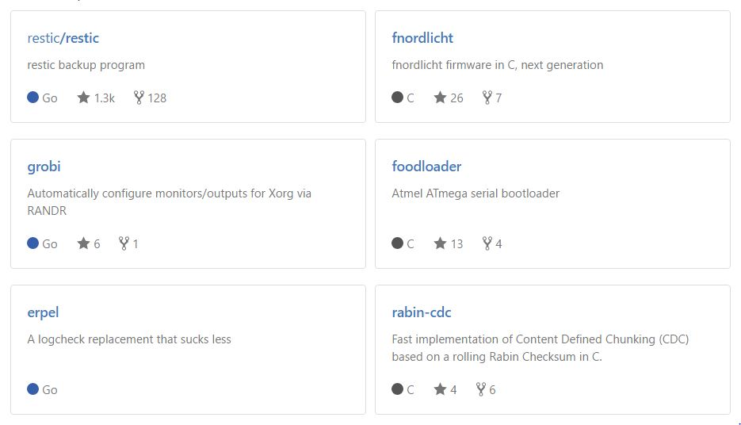
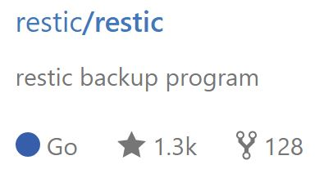
restic Authorship
Alexander Neumann, https://github.com/fd0, Germany

Slide 11
restic Lightning Talk
2015-02-01: Lightning Talk at FOSDEM 2015: A short introduction (with slightly outdated command line)
https://youtu.be/oM-MfeflUZ8?t=11m49s

Slide 12
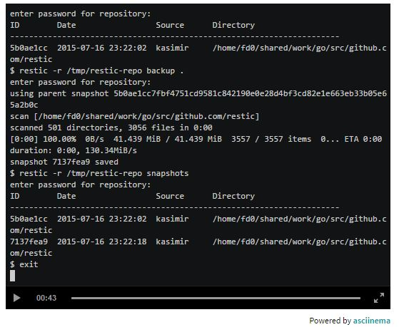
Quickstart
A short recorded demo of restic
$restic -r /tmp/restic-repo init
enter password for new backend:
enter password again:
Created restic backend NNNNNNNN at /tmp/restic-repo
Please note that knowledge of your password is required … Losing your password means that your data is irrecoverably lost.
$ls -al
$restic -r /tmp/restic-repo backup .
Enter password for repostiory:
Source: https://restic.github.io/

Slide 13
Flow
Init repository
Backup files / directories / lists (with optional tags)
Snapshot history
Restore
Forget (policy qualifications) then periodically Prune
Check (for integrity)

Slide 14
Common Commands - For Backup and Restore
$ ./restic --help
$ ./restic init --repo /tmp/backup (Initialize a repository)
$ ./restic -r /tmp/backup backup ~/work (create snapshot at point in time - ie. backup data)
$ ./restic -r /tmp/backup backup ~/work.txt (backup individual file)
$./restic -r /tmp/backup snapshots (list all snapshots)
$ ./restic -r /tmp/backup snapshots --path="/srv" (filter by path name)
$ restic -r /tmp/backup restore 79766175 --target ~/tmp/restore-work
$ restic -r /tmp/backup check (check integrity and consistency)

Slide 15
Common Commands - Forgetting and Pruning
$ restic -r /tmp/backup snapshots enter password for repository: ID Date Host Tags Directory ---------------------------------------------------------------------- 40dc1520 2015-05-08 21:38:30 kasimir /home/user/work 79766175 2015-05-08 21:40:19 kasimir /home/user/work bdbd3439 2015-05-08 21:45:17 luigi /home/art
$ restic -r /tmp/backup forget bdbd3439 (removes references to data)
$ restic -r /tmp/backup prune (required to cleanup unreferenced data)

Slide 16
Fancy Command - Exclude
Exclude folders / files by specifying exclude patterns
$ cat exclude # exclude go-files *.go # exclude foo/x/y/z/bar foo/x/bar foo/bar foo/**/bar $ restic -r /tmp/backup backup ~/work --exclude=*.c --exclude-file=exclude
Source: https://restic.readthedocs.io/en/latest/Manual/

Slide 17
Fancy Command - Filter and choose from File
backup files that have a certain filename in them
$ find /tmp/somefiles | grep 'PATTERN' > /tmp/files_to_backup
use restic to backup the filtered files
$ restic -r /tmp/backup backup --files-from /tmp/files_to_backup
combine --files-from with the normal files args
$restic -r /tmp/backup backup --files-from /tmp/files_to_backup /tmp/some_additional_file

Slide 18
Fancy Command - Tags
Snapshots can have one or more tags, short strings which add identifying information. Just specify the tags for a snapshot with --tag
$ restic -r /tmp/backup backup --tag projectX ~/shared/work/web [...]

Slide 19
Advanced Commands (we won’t cover them all...)
Mount a repository and browse backup as a regular file system (via FUSE)
Create an SFTP repository (set up SSH server, use the URL scheme with init)
$ restic -r sftp:user@host:/tmp/backup init
Create a REST server repository (backup via HTTP or HTTPS)
Create an Amazon S3 repository
Create a Minio Server repository
$ restic -r /tmp/backup list snapshots (blobs, packs, index, snapshots, keys or locks)
Removing snapshots according to a policy (This we do cover … in the next slide)

Slide 20
How to run backups on a schedule?
You can use a cron job but the question becomes how to pass the password?
The environment variable RESTIC_PASSWORD allows you to set the password for the automated backup process. This is documented in the manual here http://restic.readthedocs.io/en/latest/Manual/#initialize-a-repository
Since environment variables may be shown in the ps outputs, which may sometime sbe written to log files for diagnostic reasons, having the password in a env variable isn’t always the best. So they added a feature to store the password in a file https://github.com/restic/restic/issues/278 and also here https://github.com/restic/restic/pull/613
Source: https://github.com/restic/restic/issues/519

Slide 21
Policy
command-line parameter --dry-run (print which snapshots would be removed)
The forget command accepts the following parameters:
--keep-last n (never delete the n last - most recent - snapshots) --keep-hourly n (for last n hours a snapshot was made, keep only the last snapshot for each hour) --keep-daily n (for last n days which have one or more snapshots, keep last one for that day) --keep-weekly n (for last n weeks, keep the last one for that week) --keep-monthly n (for last n months which have one or more snapshots, keep the last one for month) --keep-yearly n (for last n years which have one or more snapshots, keep the last one for year) --keep-tag (keep snapshots with all tags specified by this option-can be specified multiple times)

Slide 22
Version History
v0.4.0 (2017-02-02) Begins shipping pre-compiled binaries
Restic Release Page: https://github.com/restic/restic/releases/tag/v0.4.0
v0.3.3 (2017-01-08) Maintenance
v0.3.2 (2016-12-18)
v0.3.1 (2016-12-13)
v0.3.0 (2016-10-02)
v0.2.0 (2016-07-30)
v0.1.0 (2015-08-21) First public release of restic (1122 commits to master since this first public release)
Debian Package: https://packages.debian.org/sid/main/restic

Slide 23
Building restic
“restic is written in the Go programming language and you need at least Go version 1.6. Building restic may also work with older versions of Go, but that's not supported. See the Getting started guide of the Go project for instructions how to install Go.” In order to build restic from source ...
Notes:
https://restic.readthedocs.io/en/latest/Manual/

Slide 24
Build restic yourself
$ git clone https://github.com/restic/restic [...] $ cd restic $ go run build.go

Slide 25
Design Principle - Easy
Easy: Doing backups should be a frictionless process, otherwise you might be tempted to skip it. Restic should be easy to configure and use, so that, in the event of a data loss, you can just restore it. Likewise, restoring data should not be complicated.
https://github.com/restic/restic/blob/master/doc/index.md

Slide 26
Design Principle - Fast
Fast: Backing up your data with restic should only be limited by your network or hard disk bandwidth so that you can backup your files every day. Nobody does backups if it takes too much time. Restoring backups should only transfer data that is needed for the files that are to be restored, so that this process is also fast.
https://github.com/restic/restic/blob/master/doc/index.md

Slide 27
Design Principle - Verifiable
Verifiable: Much more important than backup is restore, so restic enables you to easily verify that all data can be restored.
https://github.com/restic/restic/blob/master/doc/index.md

Slide 28
Design Principle - Secure
Secure: restic uses cryptography to guarantee confidentiality and integrity of your data. The location the backup data is stored is assumed not to be a trusted environment (e.g. a shared space where others like system administrators are able to access your backups). Restic is built to secure your data against such attackers.
https://github.com/restic/restic/blob/master/doc/index.md

Slide 29
Design Principle - Efficient
Efficient: With the growth of data, additional snapshots should only take the storage of the actual increment. Even more, duplicate data should be de-duplicated before it is actually written to the storage back end to save precious backup space.
https://github.com/restic/restic/blob/master/doc/index.md

Slide 30
Design Principle - Free
Free: restic is free software and licensed under the BSD 2-Clause License and actively developed on GitHub.
https://restic.github.io/

Slide 31
Compatibility?
Backward compatibility for backups is important so that our users are always able to restore saved data. Therefore restic follows Semantic Versioning to clearly define which versions are compatible. The repository and data structures contained therein are considered the "Public API" in the sense of Semantic Versioning. This goes for all released versions of restic, this may not be the case for the master branch. We guarantee backward compatibility of all repositories within one major version; as long as we do not increment the major version, data can be read and restored. We strive to be fully backward compatible to all prior versions.
https://github.com/restic/restic/blob/master/doc/index.md

Slide 32
restic Trivia
Joe Restic was the longest-serving football coach at Harvard
His idea? Restic’s 2011 obituary in the NY Times
“create doubt in the best athletes,” as Restic once put it.
Notes:
http://www.nytimes.com/2011/12/12/sports/ncaafootball/joe-restic-an-innovator-in-football-at-harvard-dies-at-85.html

Slide 33
References
restic Introduction - https://restic.github.io/
Restic design document - https://restic.readthedocs.io/en/stable/Design/
GitHub Source
https://github.com/restic/restic
Manual - overview of the basic functionality provided by restic
https://restic.readthedocs.io/en/latest/Manual/
Documentation for restic
https://restic.readthedocs.io/en/latest/
GoDocs - https://godoc.org/github.com/howeyc/restic
Lightning Talk - Why another backup program?

Slide 34
Q & A
Thank you!
Questions?

