Slide 1
Boston Linux/Unix
Annual Cryptology Talk
September 15, 2021
Bill Ricker
(Annual Web of Trust signing deferred ...due to you-know-what... and maybe forever ...)

Slide 2
Agenda
2021 Cryptology News in Review
PGP Alternatives
2021 the number
History Resources
Part II of RUBICON/MINERVA (continued from 2020, YT)

Slide 3
2021 News - Cracks
Solar Winds supply-chain hack bypassed multi-factor by forging MFA cookie using stolen integration secret key. (BS-CG)
Final Zodiac Killer cipher cracked with computer assist. YT
Grandson of Spectre/Meltdown abuses μOp cache

Slide 4
Breaking Caesar and Vigenere by quantum computers?
ia.cr/2021/554
Sounds like overkill and also beyond today.
A prof commented dryly that his “students ran Caesar with 20 qubits and IBM HW had stability difficulty”

Slide 5
2021 News - Factoring
“Fast Factoring Integers by SVP Algorithms, corrected”
2021/232 withdrawn; ia.cr/2021/933
claimed Factoring breakthrough
Crypto/security world pauses, frantically reads, and yawns.
[StackExchange]
Running Commentary
BS-[2021.03.05]
Twitter
Justin Troutman @justintroutman
Chosen abstracts are the new chosen plaintexts.
Sophie, @SchmiegSophie
I think the paper unfortunately says more about Schnorr than it says about RSA. I'll leave it at that, it of respect for his contributions to the field.
@EllipticKiwi
I have no time to look at the paper today, but he has been talking about lattice algs for factoring for more than 10 years, and making very bold claims
Stefano Tessaro @StefanoMTessaro
Since the rump session at EUROCRYPT '09, where he even claimed polynomial time. It is the same paper, which has evolved over the years. (One can find several drafts of it.)
Carsten Baum @crypto_carsten
Ah ok, didn't know about that. So we might classify the paper as age-induced weirdness.

Slide 6
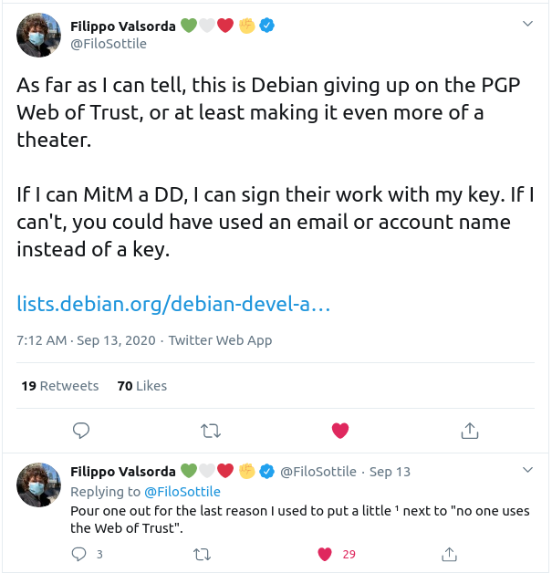
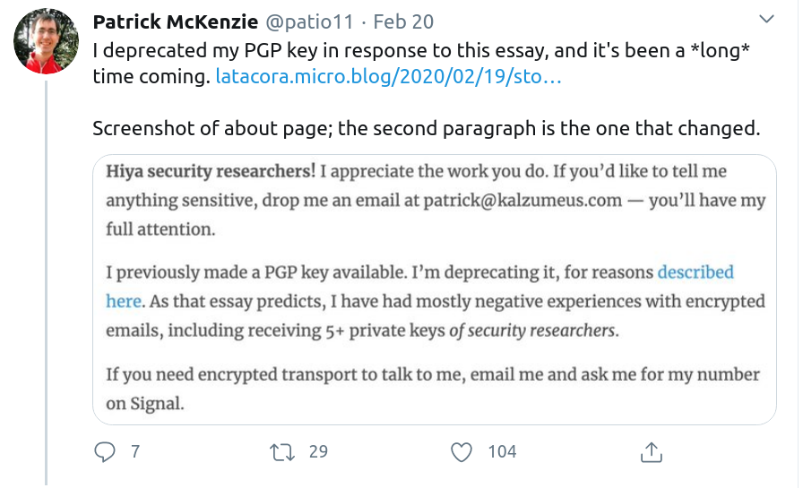
PGP? Maybe not ...
DD has alternate trust root now
“DAM Key and identity requirements” 9/13
(Still need GPG to sign uploads)
Latacora
“Stop Using Encrypted Email” 2020
“The PGP Problem” 2019
2020 rerun, 2019 rerun ...

Slide 7
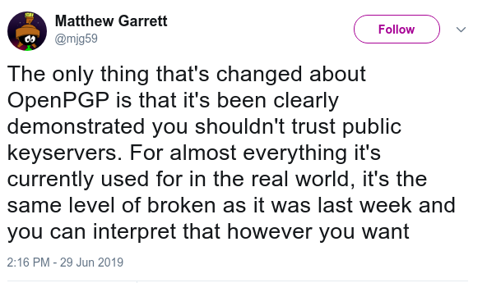
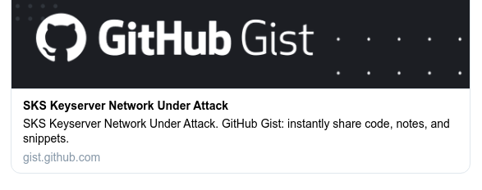
PGP Update
https://gist.github.com/rjhansen/67ab921ffb4084c865b3618d6955275f
2019 rerun ...

Slide 8
Why all the PGP h8?
The Math is fine. (At least for now.)
The support-all-use-cases UX is terrible.
Why don’t HR, Banker, Contracts office have PGP?
Which can result in crypto fails as well as just fail fails.
Normal people need fit-for-purpose tools not Legos™
Can’t replace a flawed magic hammer with another single magic hammer
2019 rerun ...

Slide 9
Alternatives
Everything depends on threat model
Threat Model is (partly) different per mode
Is your opponent
The auditor / avoiding data breach
A hostile nation-state with massive intel budget
A police-state with unrestained ethics
Nosy journalists
Your sister/boss/sysop
2019 rerun ...

Slide 10
Alternatives - Email
Modern email supports point-to-point secure delivery
secures meta-data better than PGP;
encrypted in transit, but not at rest, may be good enough depending on threat model/regulatory
Put sensitive content in an encrypted attachment
Or, specialized vendor – often for Corp use, where Audit access to secured emails required and/or easy interface needed for support staff
2019 rerun ...

Slide 11
Alternatives – files/attachments
Password on a ZIP
usually weak encryption,
sometimes good enough (check threat model)
most people have the software already
Cloud
Keybase Filesystem but Zoom/China?
Or any File cryptor & any cloud
Magic-wormhole - send file interactively (like chat)
Weak password + interaction = strong; live > store’n’forward
Uses Rendezvous, PAKE
Password Authenticated Key Excange => out-of-band horse-stapler passphrase
2016 slide deck
2019 rerun ...

Slide 12
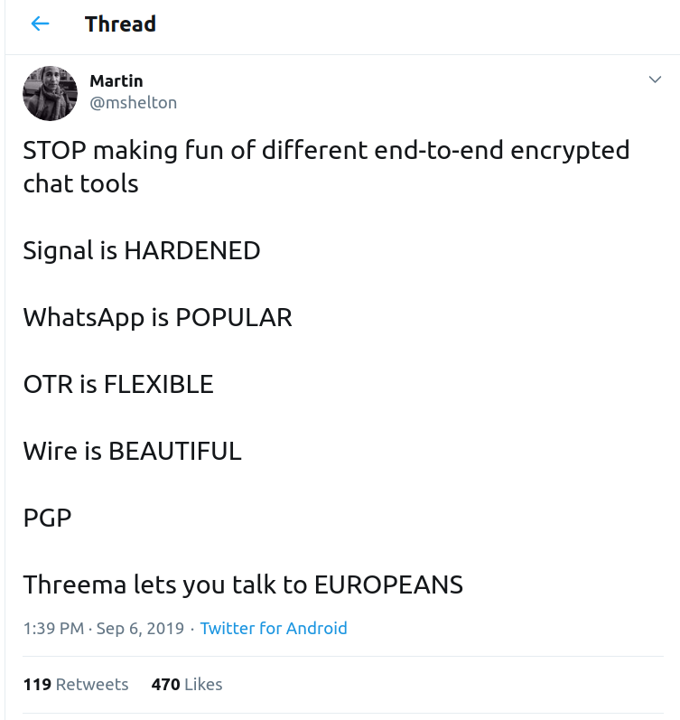
Alternatives - Chat
Secure chat E2E easier to automate key management securely than eMail
Stream (vs store’n’forward) avoids issues
Choices
Add “keybase chat” but Zoom/China?
2019 rerun ...

Slide 13
Alternatives: Blobs, Files
Secured Data blobs on disk or in cloud
nacl/box
nacl/secretbox.
Keybase saltpack (NACL usecase packaging)
Eureka
Magic Wormhole
Syncronous only
2019 rerun ...

Slide 14
Alternatives: Key Server
Keybase.io
alas has been sold to Zoom; check your threat model!
Put key hash in .sig and key on personal site
Send public key via secure E2E chat
But still need to avoid the PGP problem of sending the private key by mistake!!
Will new frameworks make that confusion less likely?
2019 rerun ...

Slide 15
Alternatives: Signed software
Debian packages
largest de facto use of PGP
alternative to Web of Trust for new DD/DM
Still using GPG signatures for uploads
OpenBSD has signify & minisign
uses ED25519
The Update Framework (TUF) provides Notary service

Slide 16
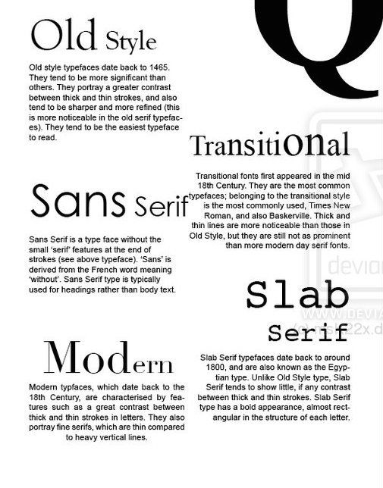
Eras of Cryptology?
So … What came between Classical & Modern?
“Transitional” (e.g. in WW2 and “Cold War”) 1935-1975
(nearly) All broken during WW2, but kept classified … so surplus resold after the war ...
Mechanical
add clockwork to a decoder ring (1890s+), junk.
Hagelin/Crypto-AG – C-35/C-36/C-38=M209 “Pin&Lug” mechanical adding-machine pRNG stream additive.
Electromechanical rotors or pin-wheels
combine periods to get very long sequences; keys&lamps or teleprinters
Enigma – Scrambling electrical rotors, substitution, manual transcription – earliest successful, 1930-ish!
Tunny/Sturgeon/ABA/... - Scrambling pinwheels for 5-bit TTY current loop pulses; first on-line teleprinter !
Reinjection Rotors KL-7, HX-63, ...
Analog Electronic Scramblers (fax, voice) – FDR’s hotline
Bespoke Digital Hardware (1965-1980?)
Direct precursors of Modern Stream ciphers, successors of FISH etc.
Still in use in much of world until mid 1990s or later due to US Export Controls on Modern cryptography.
The Eras of Cryptology – analagous to Typography?
“Classical” - (hand-ciphers, code-books) 25BCE - 1935
Caesar; Vigenère; Wheatstone-Playfair; etc.
Magic Decoder Ring, Jefferson-Bazeries, etc (M-94, M-138-A)
Basically obsolete by 1900, used anyway in WW1 and even WW2 (tactical).
Computers just make it more obsolete.
“Transitional” (see right) 1935-1975
Whatever it is, “Transitional” is always whatever is between Classical & Modern is named !
“Modern” - (stored-program computers) 1975-2025
Software/Firmware. COTS processors. Run anywhere.
Block ciphers (Fiestel structure) – DES, AES, ...
Stream ciphers – RC4, Bluetooth, ...
Public-key, key negotiation, PKI Signatures (RSA, PGP,DH, EC, PKCS,
These are Modern but pre-Quantum …
⇦You are here
“Post-Quantum” (???) 2025-????
Less weird name than ironic “Post-Modern”
What-ever’s next … just in case Quantum Computing works …
2020 rerun … updated

Slide 17
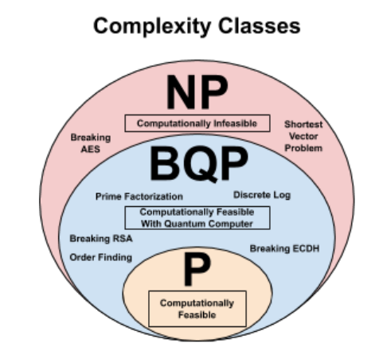
Post-Quantum Future
“Post-Quantum Cryptography”
Not about Quantum enciphering (mostly)
Practical engineering of Quantum Computing remains !
But still concern since algorithms exist if the hardware exists.
Goal: algorithms that resist Quantum cryptanalysis, in case that ever works.
NIST's Post-Quantum Cryptography competition continues
July 2020, NIST selected third-round algorithms “NIST initiated a competition to find and test algorithms for quantum encryption that would resist quantum decryption back in December of 2016. Two rounds of testing have been completed, and an initial group of 69 submissions have been winnowed to 15. These 15 are now in Round Three of the testing process, and it is anticipated that as many as 4 of them will be approved as standards. This news update is intended to bring you up to date on the process.” - HPR3147 [archive audio][HPR]
As with prior NIST selections, public cryptanalysis by peer/competitors is culling the herd. e.g. LEDAcrypt was dropped from 3d round, because its keys are easier to recover than they should be.
Target proposal for public comment 2023-2024
[Schneier 2020.09.08] Daniel Apon of NIST scribd “PQC Overview August 2020” [scribd? Really?][errata]
Candidates include Dilithium-Crystals !
NIST PQC [forum]
PQCrypto 2020 virtual conference Sept. 21-23, registration is live.
NSA Cybersecurity Directorate guidance on NIST Round-3 PQC candidates transparently shared publicly!
Germany already chosen Classic McElice and FrodoKEM
Current considerations
Non-post-quantum crypto messages can be archived today (Colorado?) for possible VENONA-style retro-exploitation if Quantum crack becomes a thing.
New desideratum beyond “Perfect Forward Secrecy”
Honeypots of nonsense as decoys??
“Keeping classified information secret in a world of quantum computing” → “Quantum Computing and Cryptography: Analysis, Risks, and Recommendations for Decisionmakers” (1) [thebulletin] (2) [LLNL PDF ]
Theme 1: “The Race for Quantum Supremacy”
The Race For Quantum Supremacy Is Primarily an Economic Race
Theme 2: “Quantum Computing Makes Current Encryption Obsolete”
Quantum Computing Will Not Make Encryption Obsolete
AES256 borderline ok … 3AES256 should be fine!
Since RSA keys are more at risk than AES, need PFS in session-key negotiations now wrto Venona II.
Ditch AES-128, AES-192 now for anything of longterm value.
Theme 3: Quantum Computing Makes New Encryption More Secure Than Current Encryption
Quantum Computing Does Not Provide A Significantly New Encryption Capability
Chinese satellite entangled demo not withstanding
2020 rerun

Slide 18
2021: product of primes
2021 = 43 * 47
Both Hagelin Pinwheel Machines (C-52 etc) and TUNNY=Lorenz SZ42 had wheels of size 43 and 47 in co-prime wheel sequence
TUNNY was broken on 25x23 rectangle showing diagonal of period 41.
C-52: 25,26,29,31,34,37,38,41,42,43,46, 47
SZ42: 43,47,51,53,59,37,61,41,31,29,26,23

Slide 19
2021: ^demo^
$ raku -e 'use Prime::Factor; say $_, ": ", $_.is-prime||prime-factors($_) for (25, 26, 29, 31, 34, 37, 38, 41, 42, 43, 46, 47)'
25: (5 5)
26: (2 13)
29: True
31: True
34: (2 17)
37: True
38: (2 19)
41: True
42: (2 3 7)
43: True
46: (2 23)
47: True
$ raku -e 'use Prime::Factor; say $_, ": ", $_.is-prime||prime-factors($_) for (43,47,51,53,59,37,61,41,31,29,26,23)'
43: True
47: True
51: (3 17)
53: True
59: True
37: True
61: True
41: True
31: True
29: True
26: (2 13) 23: True
C-52: 25, 26, 29, 31, 34, 37, 38, 41, 42, 43, 46, 47
SZ42: 43,47,51,53,59,37,61,41,31,29,26,23

Slide 20
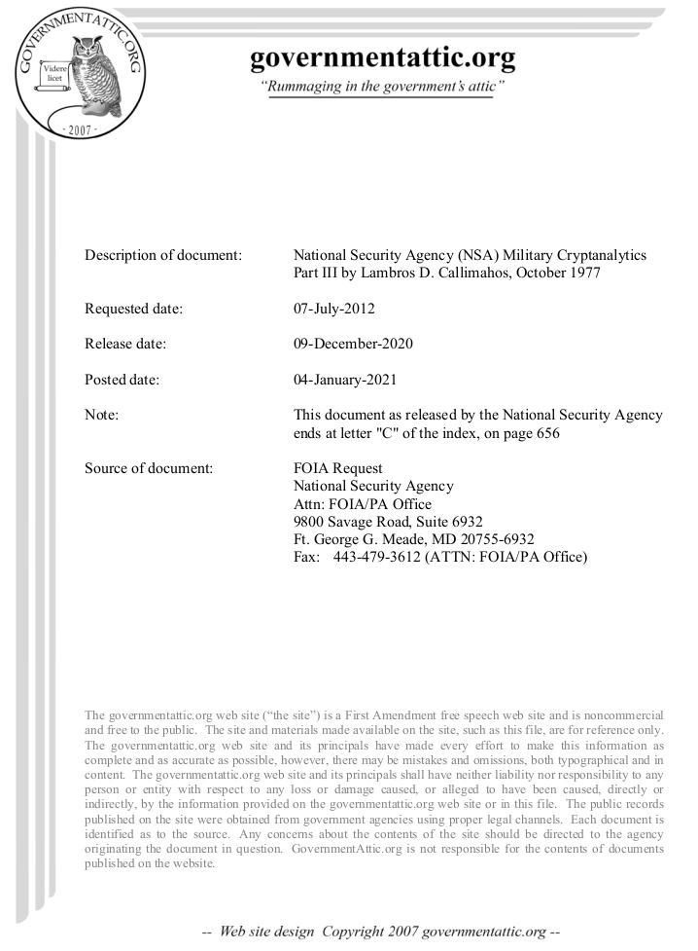
History: Newly Declassified
NSA textbook declassified (per FOIA)
Military Cryptanalytics, Part III Lambros D. Callimahos, 1977. [2021.01.04] redacted
Major expansion from WFF’s “Military Cryptanalysis Part III” text including LDC’s monographs.
“Aperiodic Substitution Systems”

Slide 21
Military Cryptanalytics, Part III
What's redacted?
One or more section titles are omitted from TOC under each of these headings:
Autokey systems
Long or continuous keys
geared disks
? Kryha improvement?
Key analysis
Cryptodiagnoses
Depth Reading
Other sections:
Interupting key, text
Cylindrical & strip
Jefferson/Bazeries/Hitt
incl. M-94 used in WW2
Cipher Device M-94 tables
Problems (classwork)

Slide 22
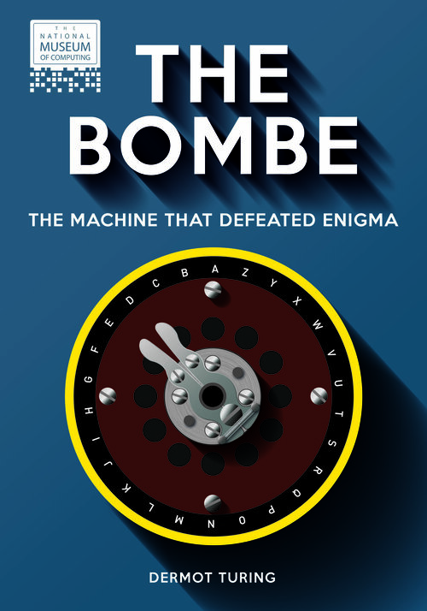
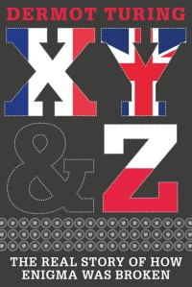
New Historical Resources
Dermot Turing, Alan’s Nephew,2 books & videos sharing credit with Poles, boffins.
Sr Historian at NSA, Lawfare podcast , VENONA
New Colossus video

Slide 23
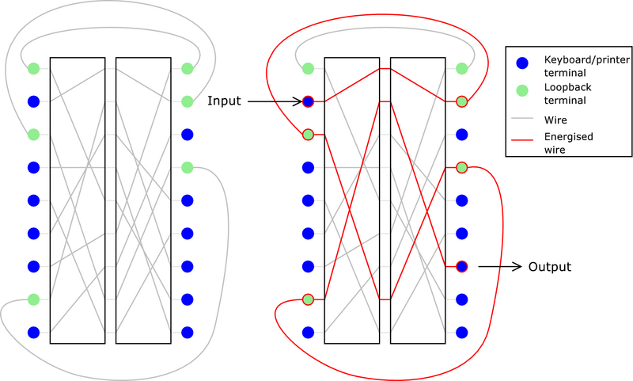
Transitional: The last Rotors
Improving on Enigma through Reinjection
US Army SIS discovered 1944
Rediscovered by industry 1953
Multiplies a Rotor machine’s security.
Rather than once thru or 1+reflect, twice or more forward (& reflects)
Unclear to me how one assures first pass is to a looped back terminal?
Or is Sometimes good enough / better?
Other half of the Minerva / Rubicon Cag story from 2020 broke in 2021

Slide 24
Hagelin CryptoAG HX-63
the other half of Rubicon/MINERVA scandal !
IEEE article published last few weeks - https://spectrum.ieee.org/the-scandalous-history-of-the-last-rotor-cipher-machine/particle-1
Hagelin/CryptoAG separately discovered the Reinjection principle
Acquired US Patent despite secret prior art!
would have been at least as secure as NSA’s own KL-7
so was quietly scuttled, too dangerous.
Only Rotor machine (vs pin-wheel) by CryptoAG; (Hagelin collaborated on one other)
Only 12 built -- 2 known to survive?

Slide 25
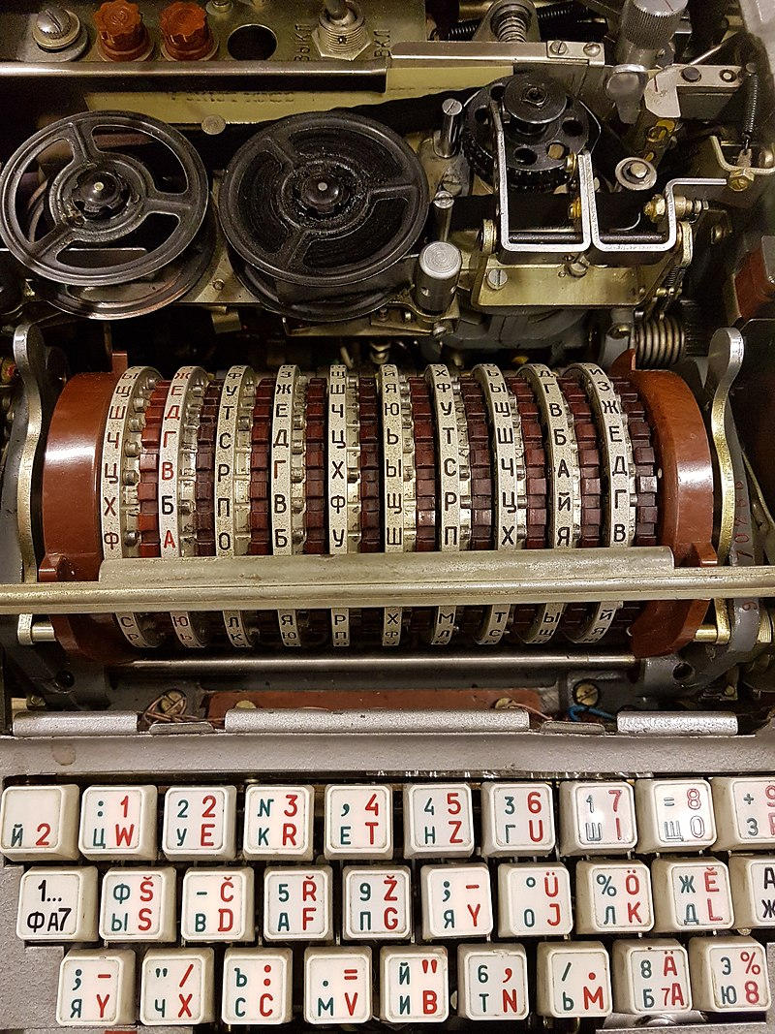
ФИАЛКА (Fialka M-125)
1956. 10 rotors, contra-rotating!
Enigma Crib-Collision avoided
Still has reflection, mostly reciprocal, but complex reflector logic
total encryption can have self-encryption 1:30 E→E (but not always E!) (1-elt fixed-point subcycle in permutation)
3 letters rotate, so nonreciprocal
Said by some to have Reinjection?
No? has 33 Cyrillic (and 26 Latin) letters coded on 30 pins, no extras
TEMPEST PSU: variably powered dummy load to maintain constant mains current draw.
By Fichtenspargel - Own work, CC BY-SA 4.0, https://commons.wikimedia.org/w/index.php?curid=75949781

Slide 26
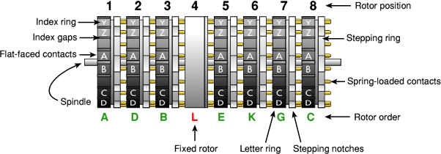
KL-7 aka AFSAM-7 , POLLUX/ADONIS
8 rotors; 26 letters + 10 reinjection = 36 contacts
Considered unbreakable by cryptanalysis then.
Internal rotor wiring and other keying leaked by Walker ring, and capture in fall of SVN.
declassified in March 2021 (after accurate simulations reverse engineered)
Synchronous timing of printer wheel
Interoperable with 10 rotor British BID/60 Singlet by correct selection of rotors.
Did Singlet have reinjection too? IDK!

Slide 27
- 73 -
Q&A ?
If none, I can scroll through the HX-63 IEEE article …
ieee

