Slide 1
Fedora 34
What is new in Fedora 34 and GNOME

Slide 2
Overview of new features
Linux Kernel 5.11
The standard Workstation version includes Gnome 3 version 40 (aka Gnome 40) This is a big change, so far looks good. I’ll focus on this
PipeWire replaces Pulse Audio - probably won’t be a major issue for our current users
I3WM spin. A tiling window manager
ARM support.
BTFS: Butter File System is the default. This was made standard in Fedora 33.

Slide 3
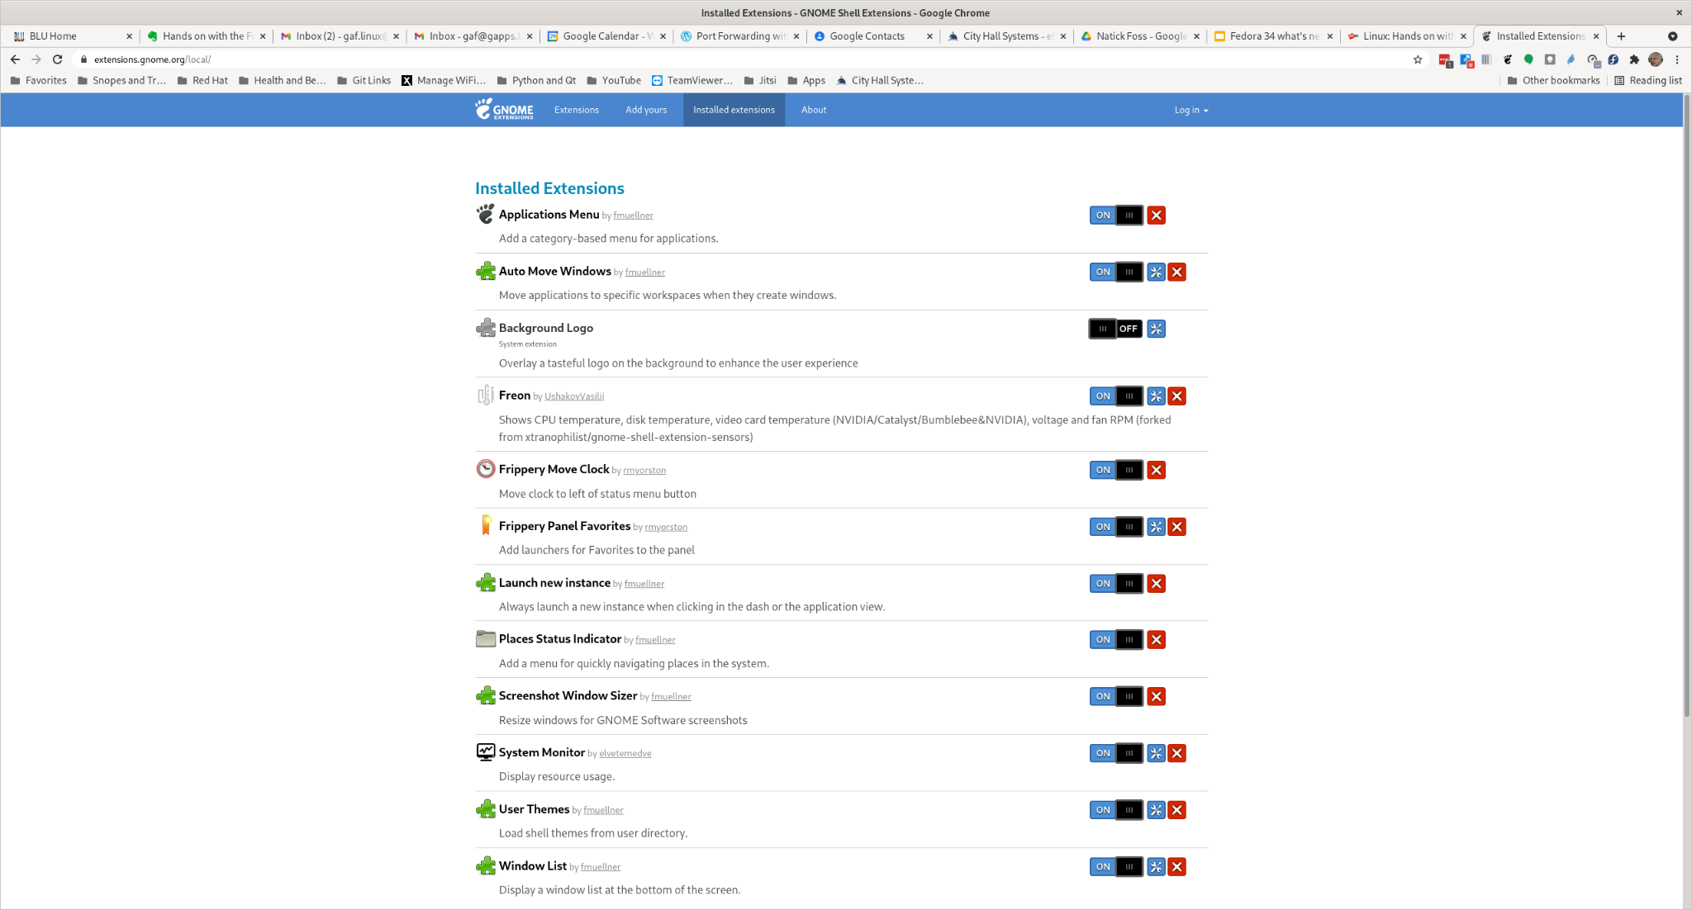
GNOME 40 changes
I’ll make a short presentation of the major changes.
First, after the installation my Gnome Shell extensions timed out so I went to the GNOME shell extensions page: https://extensions.gnome.org/

Slide 4
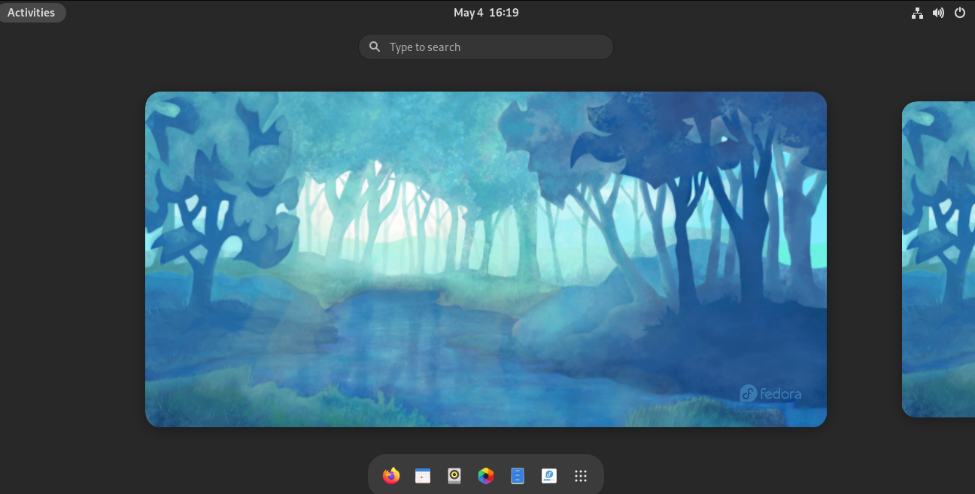
GNOME 40 changes
One major change from the previous version is as you will note, the activities is on the bottom.

Slide 5
GNOME 40 changes
Work spaces are horizontal

Slide 6
GNOME 40 Tour

Slide 7
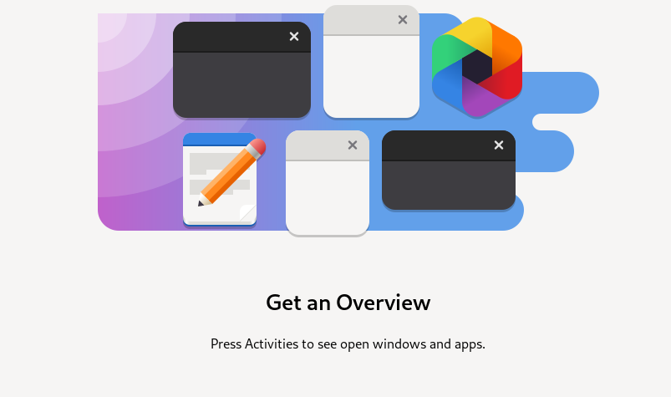

Slide 9
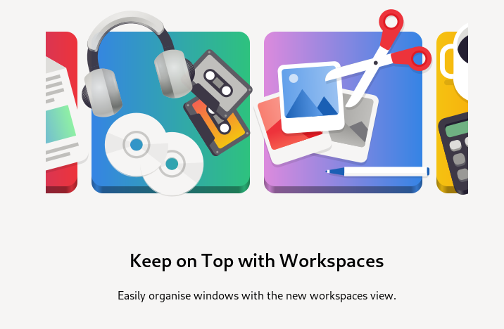

Slide 10
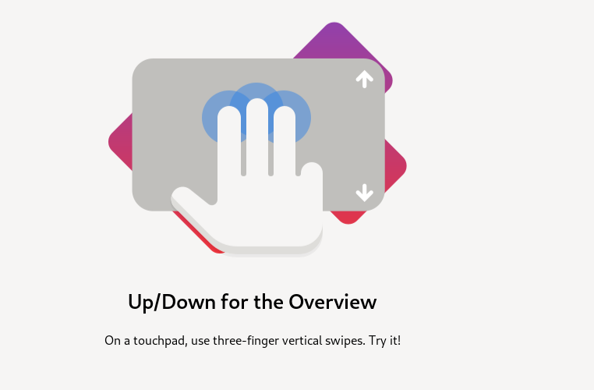

Slide 11
