Slide 1

What can Android Sense for you?
Adam Stroud and Greg Milette
1/16/2013

Slide 2

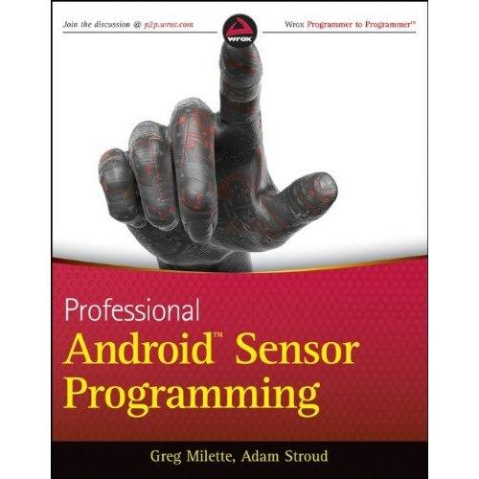

About Us
Greg: Consultant
Creator of
Digital Recipe
Sidekick App
Adam: Lead Android Developer for Runkeeper
We wrote this book

Slide 3
What is a "Sensor"
A capability that can capture measurements about the device and its external environment.

Slide 4
Sooo many sensors...
Camera
Microphone
NFC Scanner
Speech Recognition
Physical Sensors
Location Service

Slide 5
Why use Sensors?
Android Sensors can:
Hear claps and singing
See Android Logos
Understand obscure spoken language
Scan for NFCs (and do cool stuff)
Locate a device
Determine device position

Slide 6
Location Service
Using Android to determine where you are

Slide 7
Android Location Service
Provides location based functionality in Android
Determine Device Location
  Latitude
  Longitude
  Altitude
Geocoding
  Address-to-location translation
Proximity Alerts
  Notifications when device enters a specified area

Slide 8
Sources of Location Data
A location provider is a source of location information
Android has "three-ish" location providers
  Network Provider
    Makes use of Wifi access points and mobile network
  GPS Provider
    Uses GPS hardware on device
  Passive Provider
    Uses whatever other apps are currently using

Slide 9
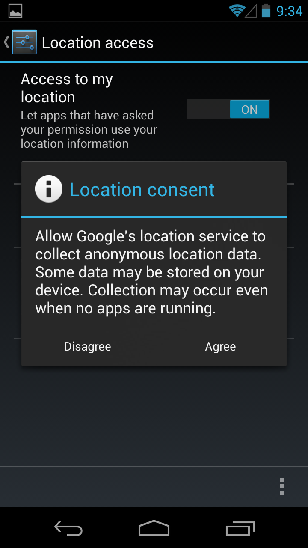
Network Provider
Wifi Access Points
  MAC addresses and strength of nearby access points recorded
Mobile Network
  Uses distance/strength of cell towers
Queries Google Location Service
  Different from local location service
  Data is somewhat crowd-sourced

Slide 10
GPS Provider
Uses on-board GPS hardware along with global GPS system
Most phones take advantage of A-GPS
  Assisted GPS (A-GPS)
    GPS information is downloaded using mobile network

Slide 11
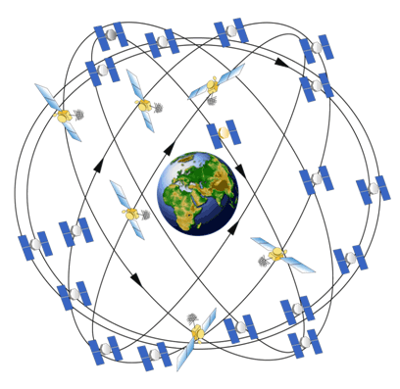
How GPS Works
GPS receiver contacts multiple GPS satellites
Data is transmitted from satellite to GPS receiver
Distance from satellite is computed using transmission time and speed of radio signal
Distance from multiple satellites are used to determine position
Image Src: http://www.gps.gov/multimedia/images/

Slide 12
Problems with GPS
Signal can face interference
  Environmental conditions
    Vegetation
  Atmospheric conditions
    Signals travel slower though gases
Not all phones have quality GPS hardware
  Low power GPS hardware can cause slow location fix
Need clear line of sight to sky
  Unlikely to work indoors
Multipath Problems

Slide 13
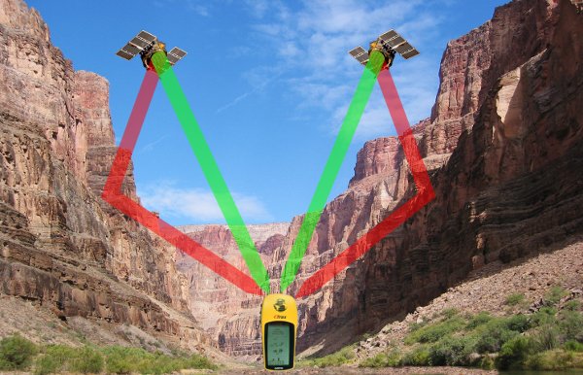
GPS Multipath
Reflected Signals
Direct Signals
By GPS_tracking_satellites.jpg: Vaughan Weather Navstar-2.jpg: NASA Canyon_midday.jpg: Realbrvhrt at en.wikipedia derivative work: Javiersanp [CC-BY-SA-3.0 (http://creativecommons.org/licenses/by-sa/3.0)], via Wikimedia Commons

Slide 14
Network Provider Comparison
 | GPS Provider | Network Provider
Time to First Fix (TTFF) | High | Low
Power Consumption | High | Low
Accuracy | High | Low
Supports Altitude | True | False
Supports Bearing | True | False
Supports Speed | True | True

Slide 15
Location Permissions
Use of the location service requires Android permission(s)
ACCESS_COARSE_LOCATION
  Network Provider
ACCESS_FINE_LOCATION
  Network Provider
  GPS Provider
  Passive Provider
Note: No need to include multiple permissions to use Network and GPS providers

Slide 16
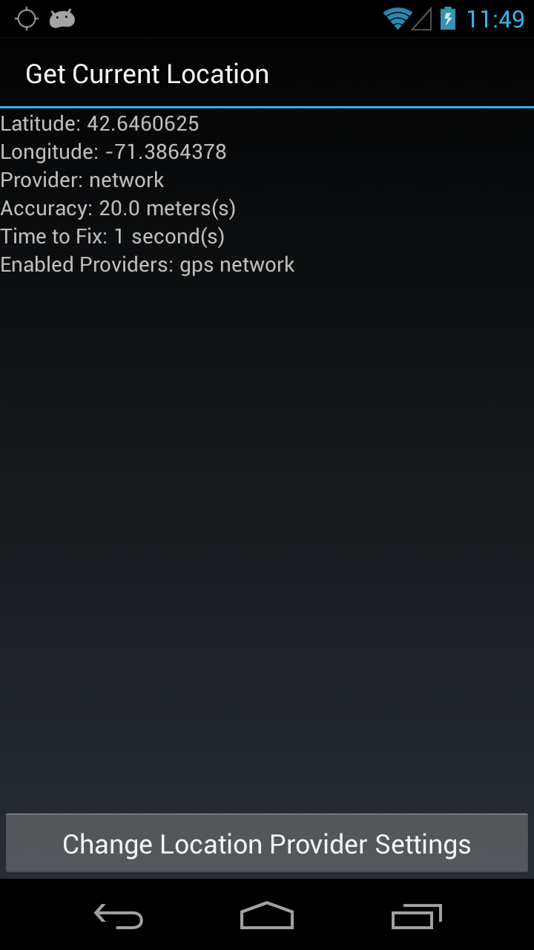
Demo: Get Current Location
Use all enabled providers
Displays information about location
  Latitude
  Longitude
  Time to fix
  Provider of location information
Allows user to enable/disable location provider

Slide 17
Location Service API
LocationManager
  System service that provides access to location information
LocationListener
  Interface containing callback methods for processing location events
Location
  Contains location data from provider
LocationProvider
  Representation of the source of location data

Slide 18
Requesting Location Data
Implement LocationListener
  onLocationChanged()
  onProviderDisabled()
  onProviderEnabled()
  onStatusChanged()
Register LocationListener with LocationManager
Process Location object in onLocationChanged()
Unregister LocationListener

Slide 19
Get LocationManager Reference
private LocationManager locationManager;
@Override
protected void onCreate(Bundle savedInstanceState)
{
super.onCreate(savedInstanceState);
setContentView(R.layout.current_location);
locationManager =
(LocationManager) getSystemService(LOCATION_SERVICE);
}

Slide 20
Register LocationListener
@Override
protected void onResume()
{
// Retrieve only providers that user has enabled
enabledProviders = locationManager.getProviders(true);
for (String enabledProvider : enabledProviders) {
// Request location information from provider.
// The current class implements LocationListener
locationManager.
requestLocationUpdates(enabledProvider, 0, 0, this);
}

Slide 21
Process Location Data
@Override
public void onLocationChanged(Location location)
{
// Read location data and update display
latValue.setText(String.valueOf(location.getLatitude()));
long.setText(String.valueOf(location.getLongitude()));
providerValue.setText(String.valueOf(location.getProvider()));
accuracyValue.setText(String.valueOf(location.getAccuracy()));
// Compute time to fix and update display
long timeToFix = SystemClock.uptimeMillis() - uptimeAtResume;
timeToFixValue.setText(String.valueOf(timeToFix / 1000));
}

Slide 22
Unregister LocationListener
@Override
protected void onPause()
{
super.onPause();
// Remove listener from location manager
locationManager.removeUpdates(this);
}

Slide 23
Summary
Android provides multiple sources of location data
Location API is relatively simple to use
Requesting location data can affect battery life
Choice of location provider depends needs of app

Slide 24
Physical Sensors
Allowing Android to sense it's place in the world

Slide 25
Sensors and Smartphones
Previously, disjoint, separate pieces of hardware
Now, unified on a single device that is mobile
Use of these sensors allows apps to inject contextual based information to their algorithms

Slide 26
Types of Sensors
Hardware (Raw) Sensors
  Provide raw data from a sensor
  Represents data from a single physical sensor
Software (Synthetic/Virtual) Sensors
  Provides abstraction layer on top of raw sensors
  Combine data of multiple raw sensors
  Modifies raw sensor data to simplify consumption
  Different devices may have different implementations

Slide 27
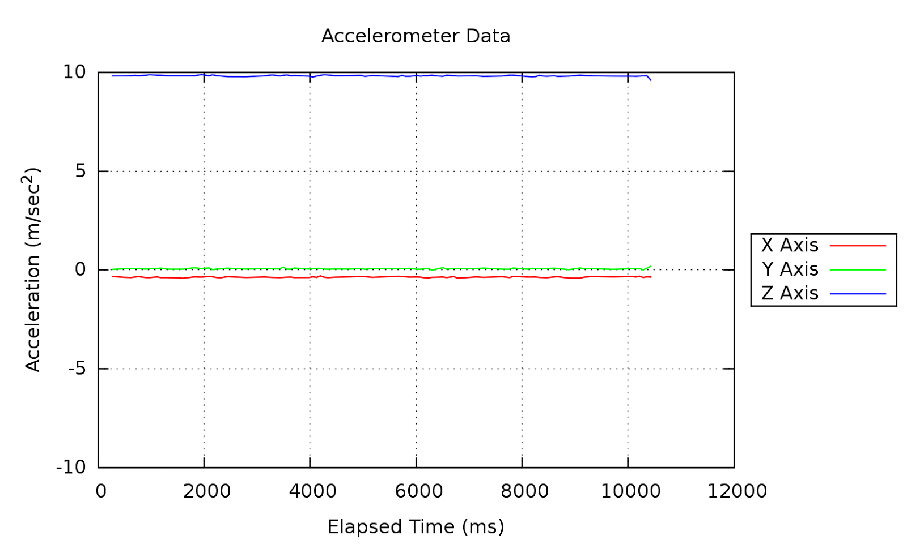
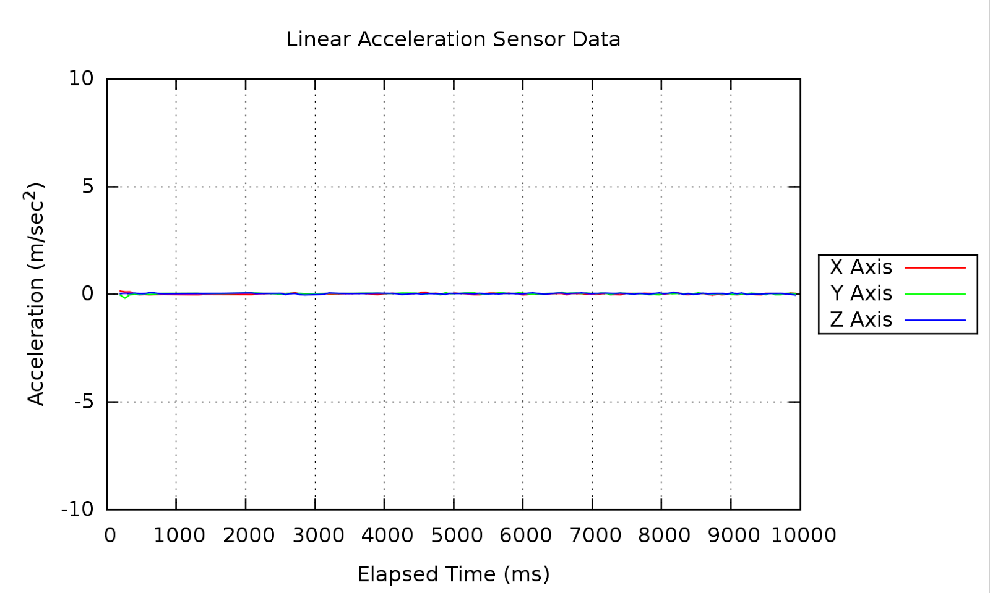
Hardware vs. Software
Data-set was captured with device laying flat on it's back

Slide 28
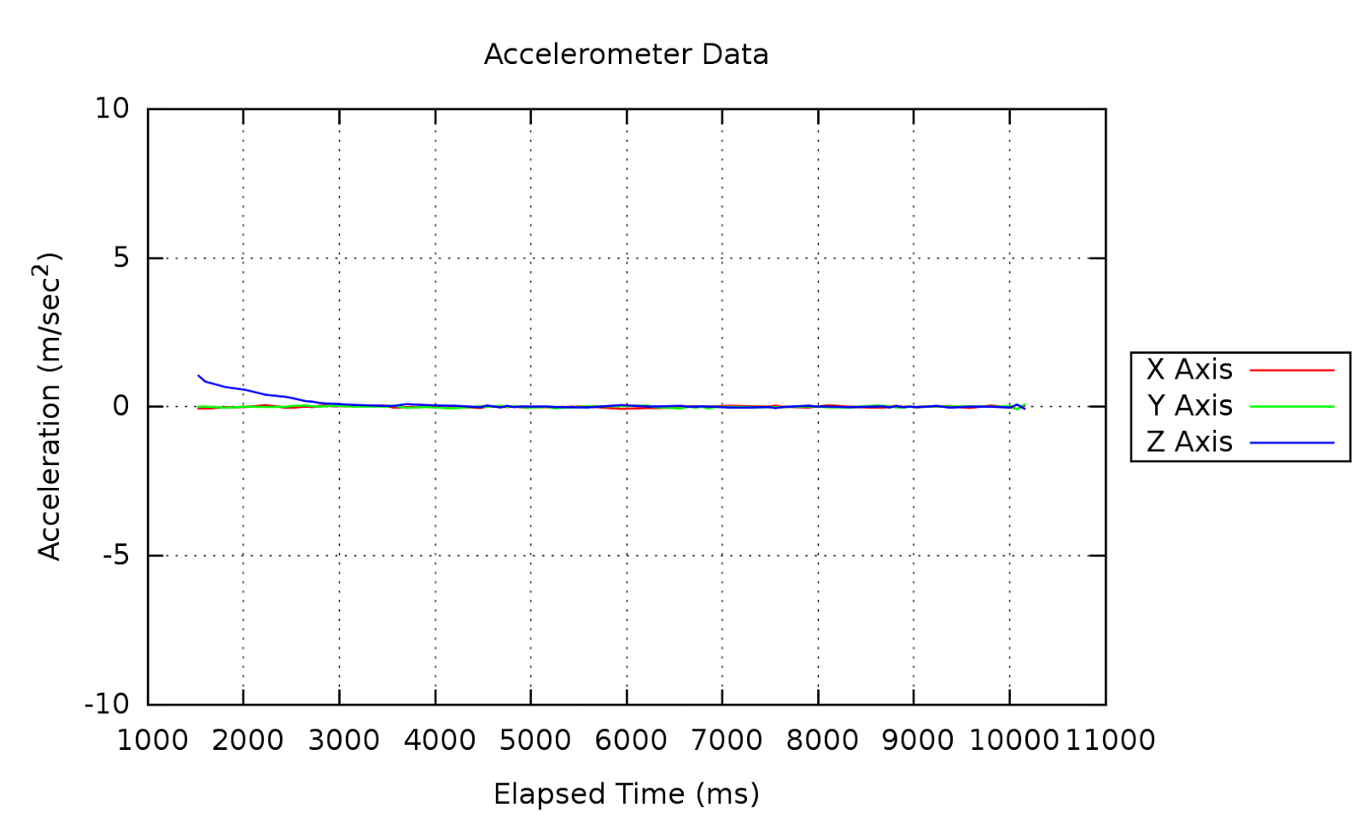
Hardware + Filter Example
Raw Data
Filtered Data

Slide 29
Types of Sensor Data
Device sensors can provide three types of data:
Environmental
  Monitor conditions of the external environment
Motion
  Detect/determine the movement of a device
Position
  Determine the position and orientation of a device

Slide 30
Environmental Sensors
Ambient Temperature
  Room Temperature
Ambient Light
  Illumination
Atmospheric Pressure
Relative ambient air humidity
Device Temperature
  Device temperature
  Worked differently across devices
  Deprecated in favor of Ambient temperature

Slide 31
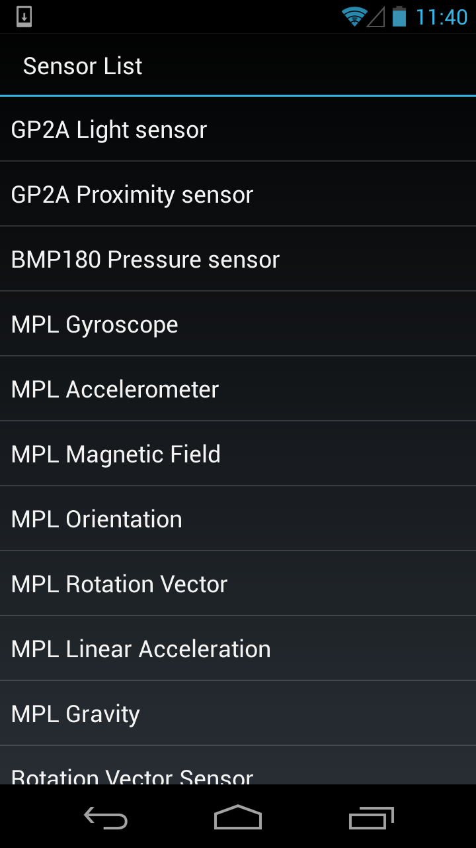
Demo: Live Sensor Data
Light Sensor
Pressure Sensor

Slide 32
Motion Sensors
Accelerometer
  Force and direction of acceleration (3-axis)
Gravity (Software)
  Isolates force of gravity by passing accelerometer data through a low-pass filter
Linear Acceleration (Software)
  Isolates acceleration data by passing accelerometer data through a high-pass filter

Slide 33
Motion Sensors Cont.
Gyroscope
  Angular speed around an axis (rate of rotation)
Rotation Vector (Software)
  Uses accelerometer, magnetometer and gyroscope to determine orientation of device

Slide 34
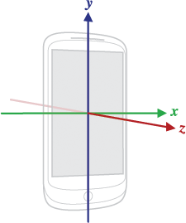
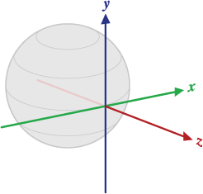
Coordinate Systems
Device Coordinate System
Global Coordinate System
Source: http://developer.android.com/reference/android/hardware/SensorEvent.html

Slide 35
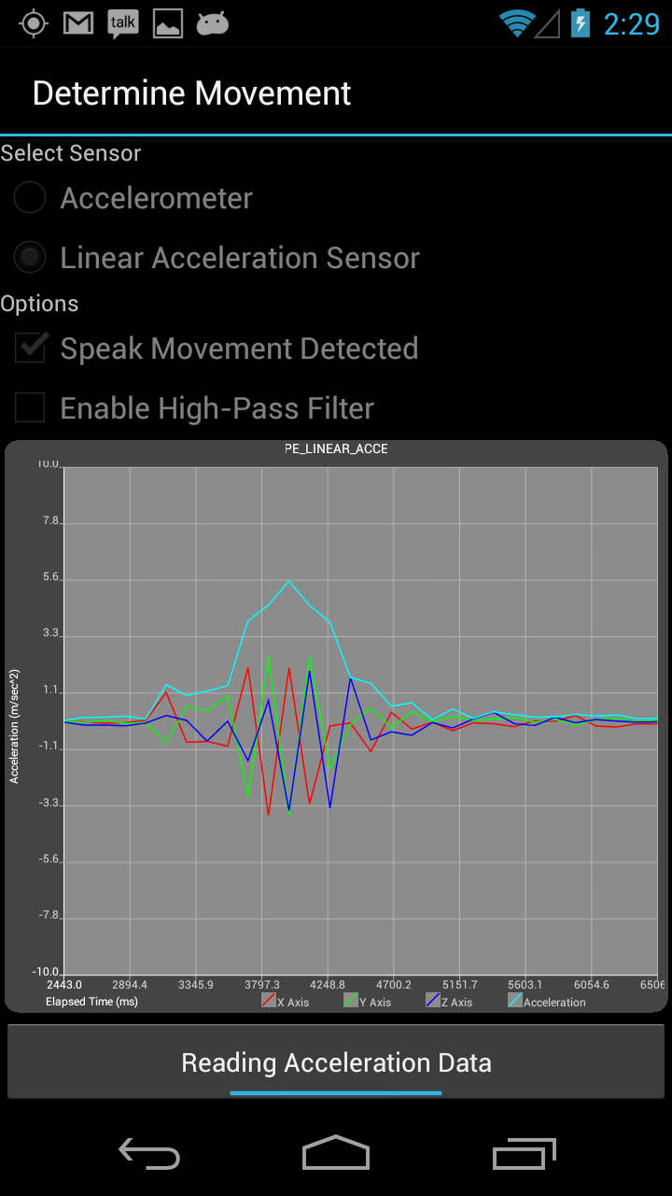
Demo: Detecting Movement
Detects movement using accelerometer and linear acceleration sensors
Conditionally passes data through a high-pass filter
Computes total acceleration to detect movement (same algorithm can be used to detect shake)

Slide 36
Position Sensors
Magnetic field
  Geomagnetic field for x, y and z axis
Proximity
  How close an object is to the front of a device
Orientation (Software, deprecated)
  Computes the azimuth, pitch and roll of a device

Slide 37
Demo: Proximity Sensor
Proximity Sensor

Slide 38
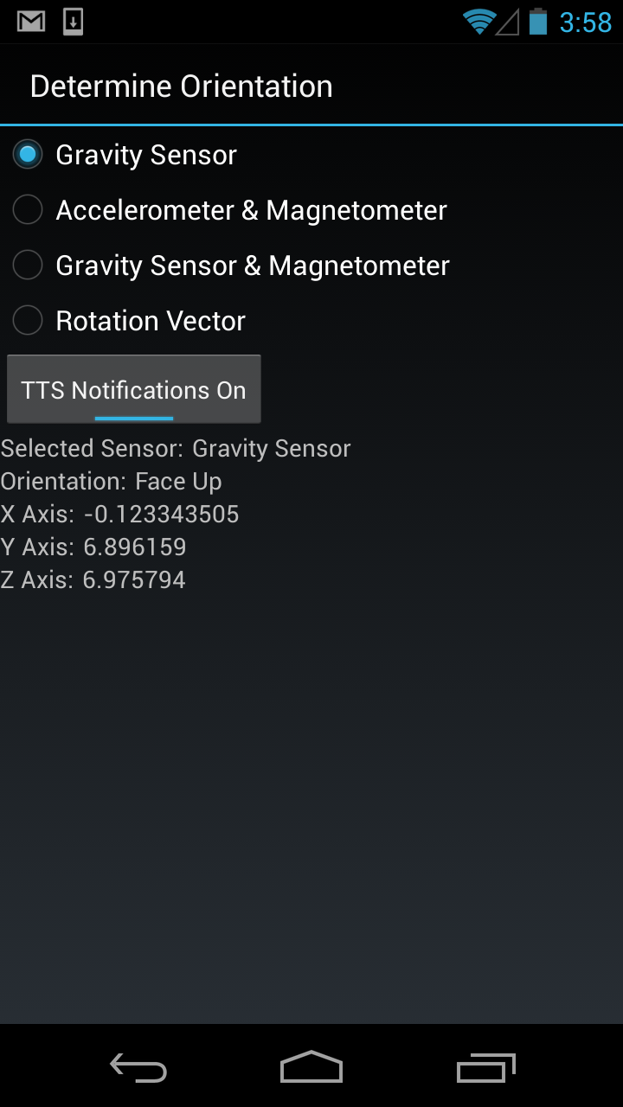
Demo: Determine Orientation
Use different approaches to determine if device is face-up or face-down
Provide insight to data

Slide 39
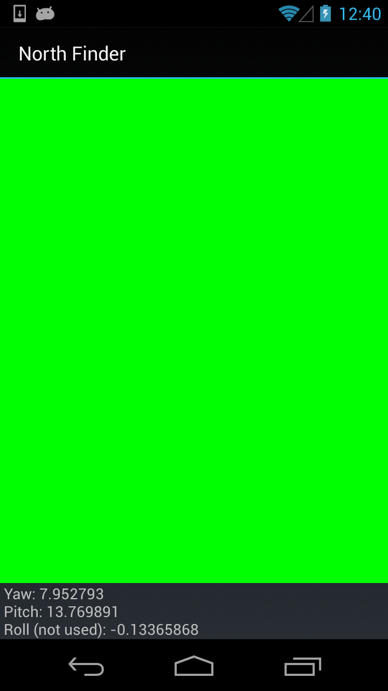
Demo: North Finder
Indicates when phone's camera is pointed within 20 degrees of north.
Basis for augmented reality app.
Direction of camera is determined using the rotation vector sensor

Slide 40
Problems with Sensor Data
Drift
  Slow wandering of values that are read
Noise
  Random fluctuation of a measured value
Zero Offset (Bias)
  Constant value applied to sensor readings
Time Delays/Dropped Data
  A busy device can cause incorrect timestamps, or dropped data.

Slide 41
Handling Sensor Error
Re-zeroing
  Re-calibrate offset that is applied to sensor data
Sensor Fusion
  Combining data from multiple sensors
Filters
  Low-Pass
    Filters out high-frequency noise
  High-Pass
    Emphasizes higher-frequency/transient components
Use of software sensors
  Many already use fusion and/or filtering

Slide 42
Summary
Android provides multiple different sensors which apps can utilize
Prefer software sensors over hardware sensors
Sensor API usage pattern is very similar to the Location API usage
After you access the sensor data, the real work begins

Slide 43
Audio Analysis
Goal: Analyze audio recordings captured from microphone
Analyze:
Amplitude only
Raw audio

Slide 44
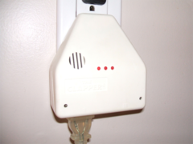
Example: Clapper

Slide 45
MediaRecorder API
int getMaxAmplitude()
Returns the maximum absolute amplitude that was sampled since the last call to this method.

Slide 46
MediaRecorder Usage
MediaRecorder recorder = prepareRecorder();
while (continueRecording) {
waitClipTime();
int maxAmplitude =
recorder.getMaxAmplitude();
continueRecording = process(maxAmplidue);
}
Notes:
And wrap this in a AsyncTask and your are done
See https://github.com/gast-lib/gast-lib/blob/master/library/src/root/gast/audio/record/MaxAmplitudeRecorder.java

Slide 47
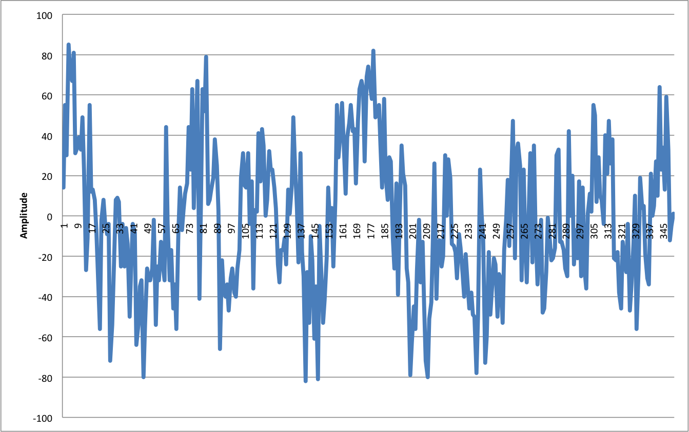
Recorded Audio

Slide 48
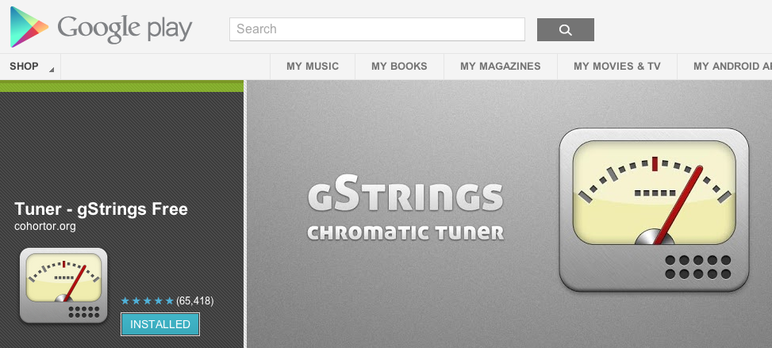
Example: Guitar Tuner

Slide 49
Calculate Volume:
Root Mean Squared
private double rootMeanSquared(short[] nums)
{
double ms = 0;
for (int i = 0; i < nums.length; i++)
{
ms += nums[i] * nums[i];
}
ms /= nums.length;
return Math.sqrt(ms);
}

Slide 50
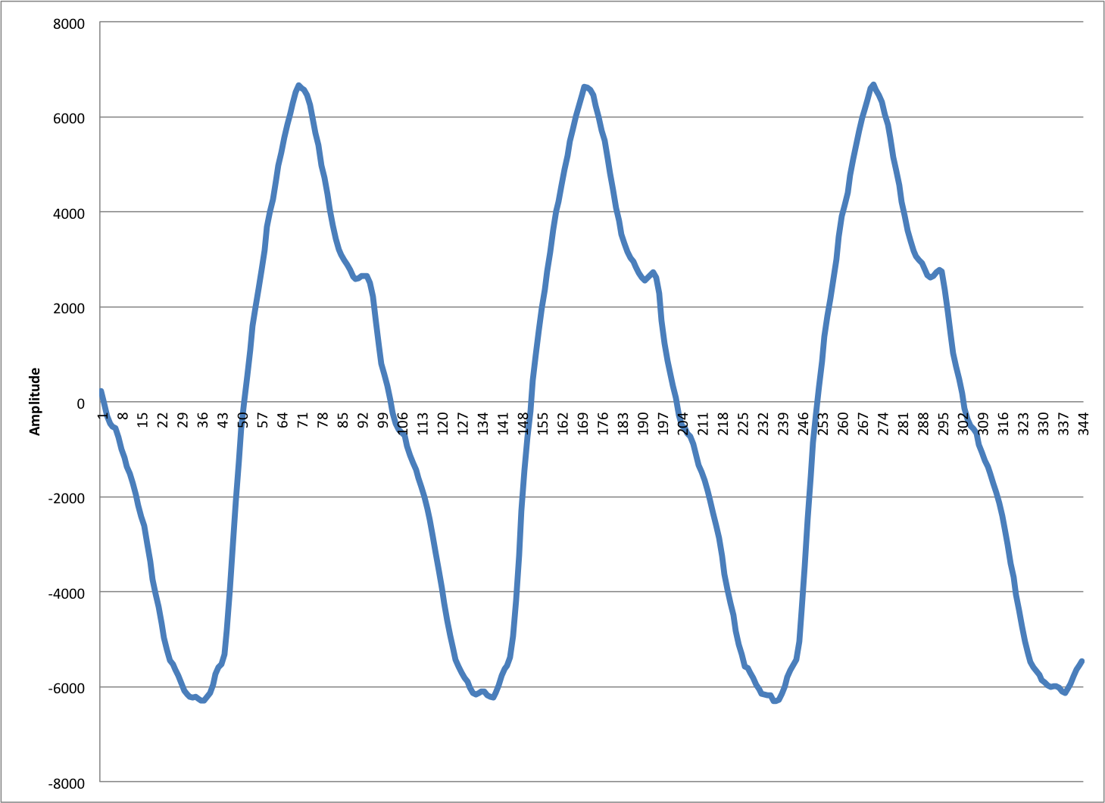
Estimate Frequency:
Zero Crossing

Slide 51
Demonstration

Slide 52
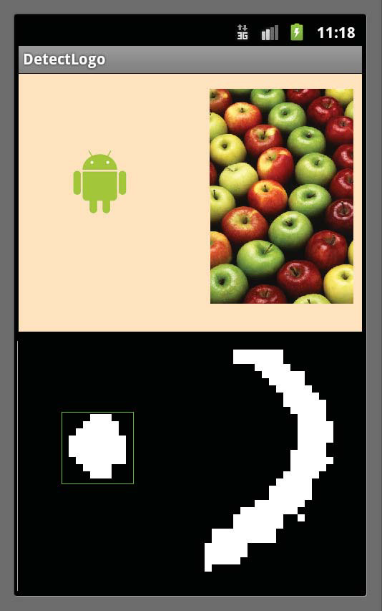
Images
Goal: Analyze images from camera

Slide 53
Image: How it works
Control the camera
  Focus
  Work with phone hardware
Process image efficiently
  Make it smaller
  Convert to black and white
Detect
  Find biggest continuous block

Slide 54
Converting to gray
RgbAbsDiffGray radg = new RgbAbsDiffGray(Color.GREEN);
Gray8Threshold g8t = new Gray8Threshold(-48, true);
mSeqThreshold = new Sequence(radg);
mSeqThreshold.add(g8t);

Slide 55
Demo: Logo detection

Slide 56
Speech Commands
Goal: Understand your spoken commands
Challenge: Recognize hard to recognize words

Slide 57
Collect speech with: RecognizerIntent
Intent intent = new Intent
(RecognizerIntent.ACTION_RECOGNIZE_SPEECH);
intent.putExtra (RecognizerIntent.EXTRA_LANGUAGE_MODEL, RecognizerIntent.LANGUAGE_MODEL_WEB_SEARCH);
intent.putExtra
(RecognizerIntent.EXTRA_PROMPT,"Speak");

Slide 58
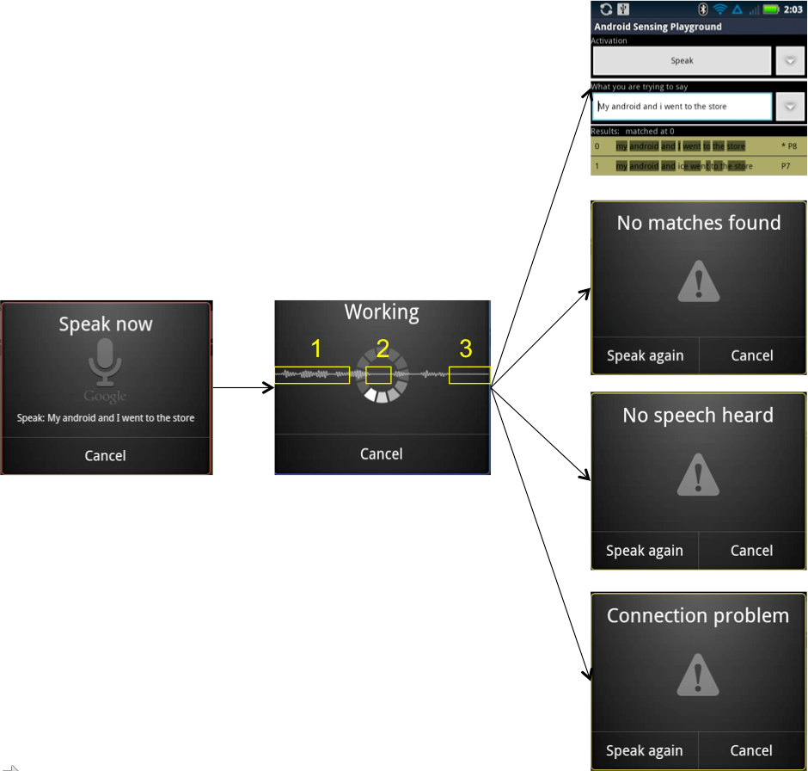
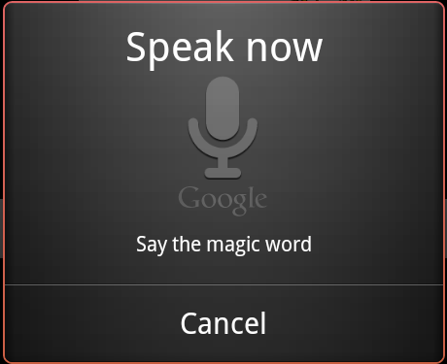
Android collects speech using dialogs and beeps

Slide 59
Recognition Results
protected void onActivityResult(int requestCode, int resultCode, Intent data) {
if (requestCode == VOICE_RECOGNITION_REQUEST_CODE){
if (resultCode == RESULT_OK) {
List<String> heard =
data.
getStringArrayListExtra
(RecognizerIntent.EXTRA_RESULTS);
//Your code here
}
}
}

Slide 60
Challenge:
Example recognition results:
"how much human"
"how much for a min"
"how much cannon"
"how much Human"
"how much planning"

Slide 61
Phonetic Matching
Cumin (C550)
Cumen (C550)
Kingman (K525)
Komen (K550)
Canon (C550)
Cannon (C550)
Human (H550)
Time (T5000)
Thyme (T500)
Whine (W500)
Mind (M530)
Notes:
Apple (A140)
Appeal (A140)
App (A100)
Awful (A140)

Slide 62
Demos
Android Sensor Playground

Slide 63
NFC
Goal: Quick access to features
How:
Write custom tag data
Register to start when user scans tag

Slide 64
Characteristics of NFC tags
Different storage sizes
  Not much (Enough for a URL)
Robustness
  Survive a washer cycle?
  Sticker

Slide 65
Write tag data with MIME type as JSON
private NdefMessage createNdefFromJson(){
String mimeType= "application/root.gast.speech.activation"
byte[] mimeBytes = mimeType.getBytes(Charset.forName("UTF-8"));
byte[] id = new byte[0];
byte[] data = new byte[0];
NdefRecord record =
new NdefRecord(NdefRecord.TNF_MIME_MEDIA, mimeBytes, id, data);
NdefMessage m = new NdefMessage(new NdefRecord[] { record });
return m;
}

Slide 66
Respond to tag scan with MIME type
<activity android:name=".speech.activation.SpeechActivationNfcTagReceiver" >
<intent-filter>
<action android:name="android.nfc.action.NDEF_DISCOVERED" />
<category android:name="android.intent.category.DEFAULT" />
<data android:mimeType="application/root.gast.speech.activation" />
</intent-filter>
</activity>

Slide 67
NFC Demo
IT assets tracking

Slide 68
Combinations of sensors: NFC, Speech Timer
1. Scan NFC
2. Trigger speech recognition
3. Timer goes off and says the time

Slide 69
Great Android Sensing Toolkit (GAST)
Code:
http://www.github.com/gast-lib
App (the name is Android Sensor Playground):
https://play.google.com/store/apps/details?id=root.gast.playground&hl=en

Slide 70
Contact Info
Adam Stroud
  Twitter: @adstro
  Email: adam.stroud@gmail.com
Greg Milette
  Twitter: @gradisontech
  Email: gregorym@gmail.com

