Slide 1
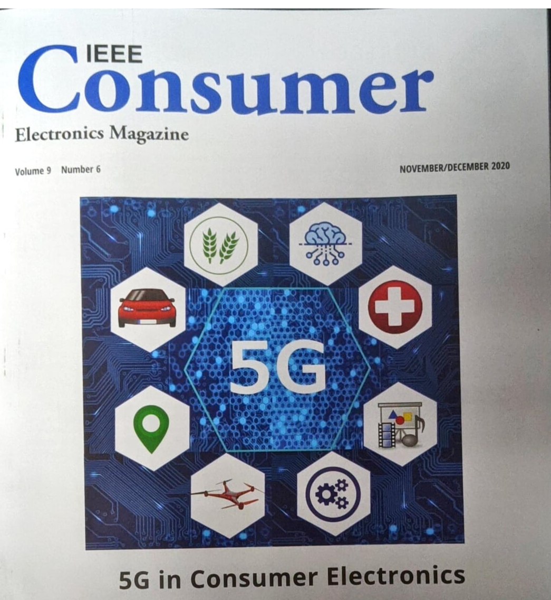
5G
Bob Frankston https://Frankston.com
Blu.org 21.Oct.2020

Slide 2
Fast Lanes! Fuck Neutrality.

Slide 3
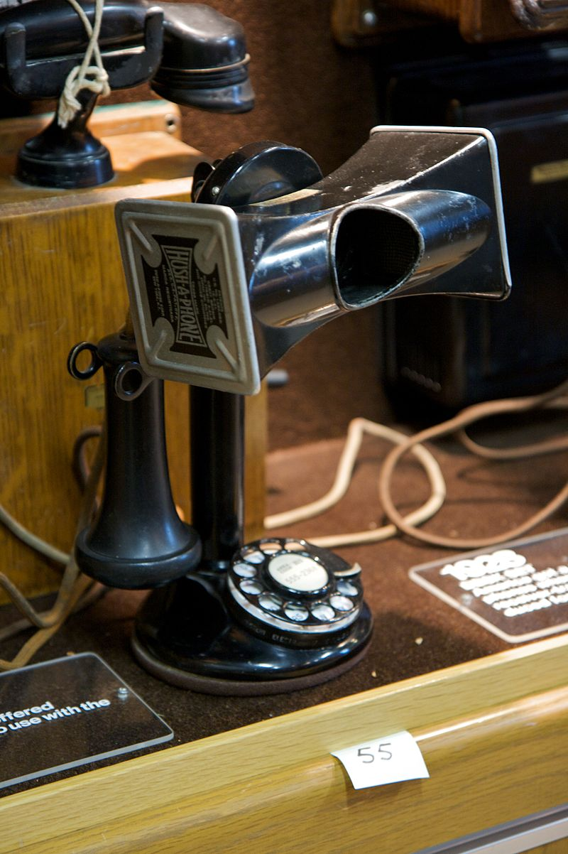
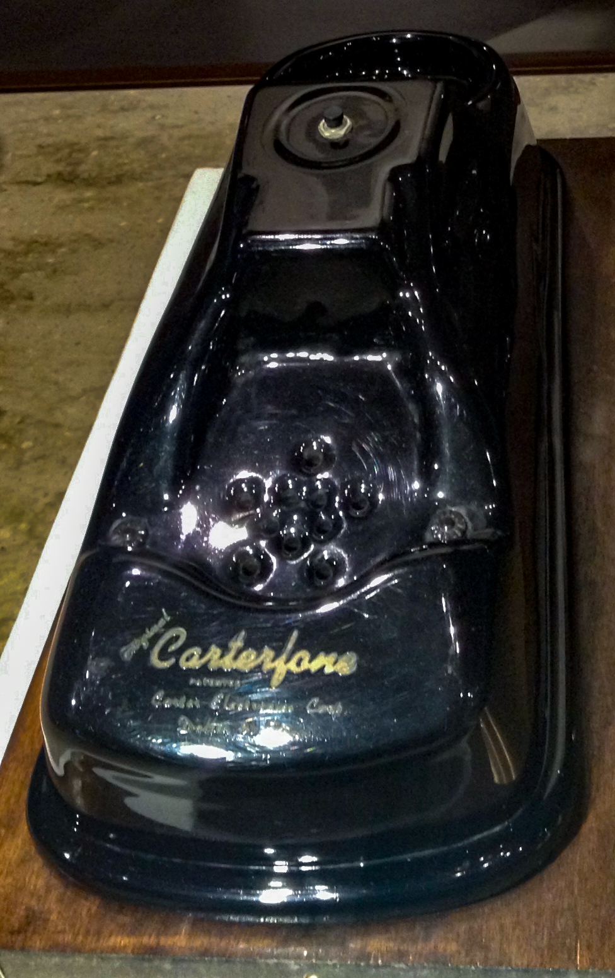
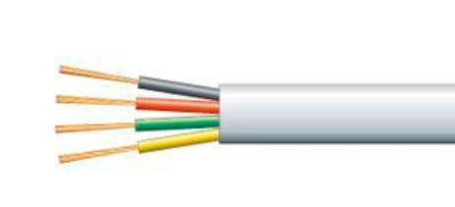
1956 Hush-a-Phone
The phone existed to deliver a service
Carterfone 1968 – you can own the instrument
Answering: Service or a machine!
Telecom Sells Services
Infrastructure is just a cost center
Captures all the value
Notes:
By Marcin Wichary from San Francisco, U.S.A. - Hush-a-phone, CC BY 2.0, https://commons.wikimedia.org/w/index.php?curid=37846803
Carterfone not to be confused with the shoephone

Slide 4
Telegraphy, Telephone, Television
Great feat of engineering!
Required every element of the system mesh precisely
Think of the 1930’s and the microsecond timing for television!
Expensive to preserve a voice signal over a distance
Led to research into “digital”
Oops – we got intelligence in our device
Yet we still continue whole systems engineering.

Slide 5
(Re)factoring & Systems Architecture
The mistake of Red/Green
Allowed value to escape the network!
The revenge of cellular and lazy engineering
Unwinds the world back before hush-a-phone
Terribly fragile protocols
Single frequency signaling
Yet today telephone is an app in our phones
Can use any transport!
Value has zoomed out of the network

Slide 6
The solution!
5G
Make the network special again!
Brand a radio as 5G!
And then use the brand on a network
Engineers and academics are complicit in aiding and abetting
Most 5G research is about local radios
Claims are all about a special network
Ignore Wi-Fi 6 and alternatives!
Drag value kick and screaming into the network.

Slide 7
Discovery of Best Efforts
ALOHAnet in Hawaii – radio packet network
No Network service
Spring 1973 Class
Metcalfe used Coax as an ether
Advisor wanted proof it “worked”
I just saw opportunity
Key is software
Enabled a conversation
Didn’t rely on a network provider to maintain salient characteristics

Slide 8
Discovery of VoIP
Packetized voice existed – isochronous!
VoIP is impossible – ear is too sensitive to jitter and noise
Yet analog cell phones worked
VocalTec origin story
Use on local LAN
Discovered it being use on wider Internet
Versus Telecom
Could not pay for favors
Didn’t have to, had the PSTN
Despite telcos!
Notes:
Psycholinguistics

Slide 9
VoIP write Larger → Zoom et al
Why is Zoom + voice free!
Why are is talking without video expensive
Why did picture phone fail?
It had to keep promises at any cost
It had to cost more than a voice call
More anomalies: Telegrams ➔ Message Units ➔ Minutes
Some got lost in translation

Slide 10
It doesn’t make sense!
Traditional engineering
Build up layers of abstraction
Hierarchical dependence
Implicit Assumption of inherent meaning
Problem Solving
Have to build a solution to a well-stated problem
Careful planning
And standards
Important in the world of hardware!

Slide 11
Millstones of Engineering
Purpose-built - Intelligence in the network
IEEE-1394 (Firewire)
CEBus (vs X10)
SS7
…5G
Problem with that approach
Limited by use cases
Others can’t add (AKA take) value

Slide 12
The Concept of Software
Works with abstractions
Meaning is NOT inherent in symbols (AKA bit strings)
Meaning comes from contact
Move physical objects by moving references, not things
A world turned upside down
Very agile

Slide 13
Intelligence leaves the network
Modelled on post office & railroads
Transport meaning as freight
Dumb end points so must preserve salience
A separate facility for each purpose
Intelligent endpoints
Can program-around whatever
Can discover uses for any facilities available

Slide 14
What is a network?
Network is a generic term
What we mean is a provider owning a path
Enables preserving salient properties
No need for intelligence at the endpoints
Alternative
Model on roadways with packets wending their way
No guarantee of delivery – just best efforts
Thus no need for a “provider”
Can composite out of local facilities

Slide 15
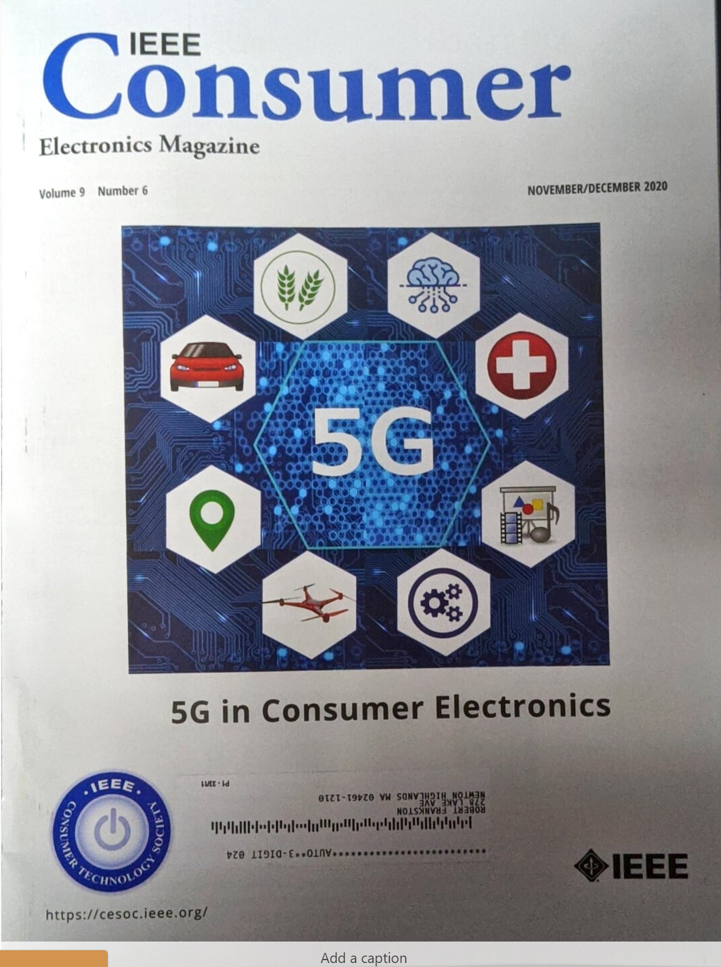
How do you pay for the network?
All the value has left the network
Drag it back in
Offer priority passes for special treatment (fast lanes)!
This works because
People assume some bits are more special than others
Researchers and engineers naïve play into this
Articles say “5G” instead of “generic connectivity” or “Wi-Fi 6”

Slide 16
Infrastructure!
Value is in the whole
So pay for the whole like roads
Composite paths out of locally owned facilities (at scale)
Become owners – no monthly fee.
More import: No paywall
Enables connected devices
Defaults to not-fail
And there is no edge, no network-as-such

Slide 17
No use case for 5G vs. generic connectivity
Generic connectivity works!
The smart network approach prevents innovation
It defaults to success
Added capacity helps all applications
No need for multiple broadbands!
But people still think their application is special
We used to need a voice network
That’s still the design point.
Con academics to say “5G” instead of connectivity and don’t mention WiFi!
More important – it means the old business model can be revived?

Slide 18
What we do need
Locally owned infrastructure
Understanding the Internet is more than the Interweb
Recognizing that endpoints are software (in things)
A new literacy

Slide 19
A Resource-based approach
Discover uses for what we found around
Can’t ask for favors for yourself
But can ask on behalf of the community
More resources create more opportunity
Fungible, AKA best-efforts, connectivity is the universal fluid

