Slide 1
AI Jumpstart Cluster
Cluster was acquired through a grant from the John Adams Innovation Institute/Massachusetts Technology Collaborative
This computer cluster combines the latest high-performance computing technology to provide resources to a community of researchers and MA industry to address next-generation challenges in the applications of artificial intelligence/machine learning (AI/ML).
The AI Jumpstart Cluster will provide unique computing capabilities leveraging high performance Graphics Processing Unit (GPU) acceleration and network connectivity
Project includes Northeastern, Boston University and Tufts University
Microway was the prime vendor (thank you Eliot)!

Slide 2
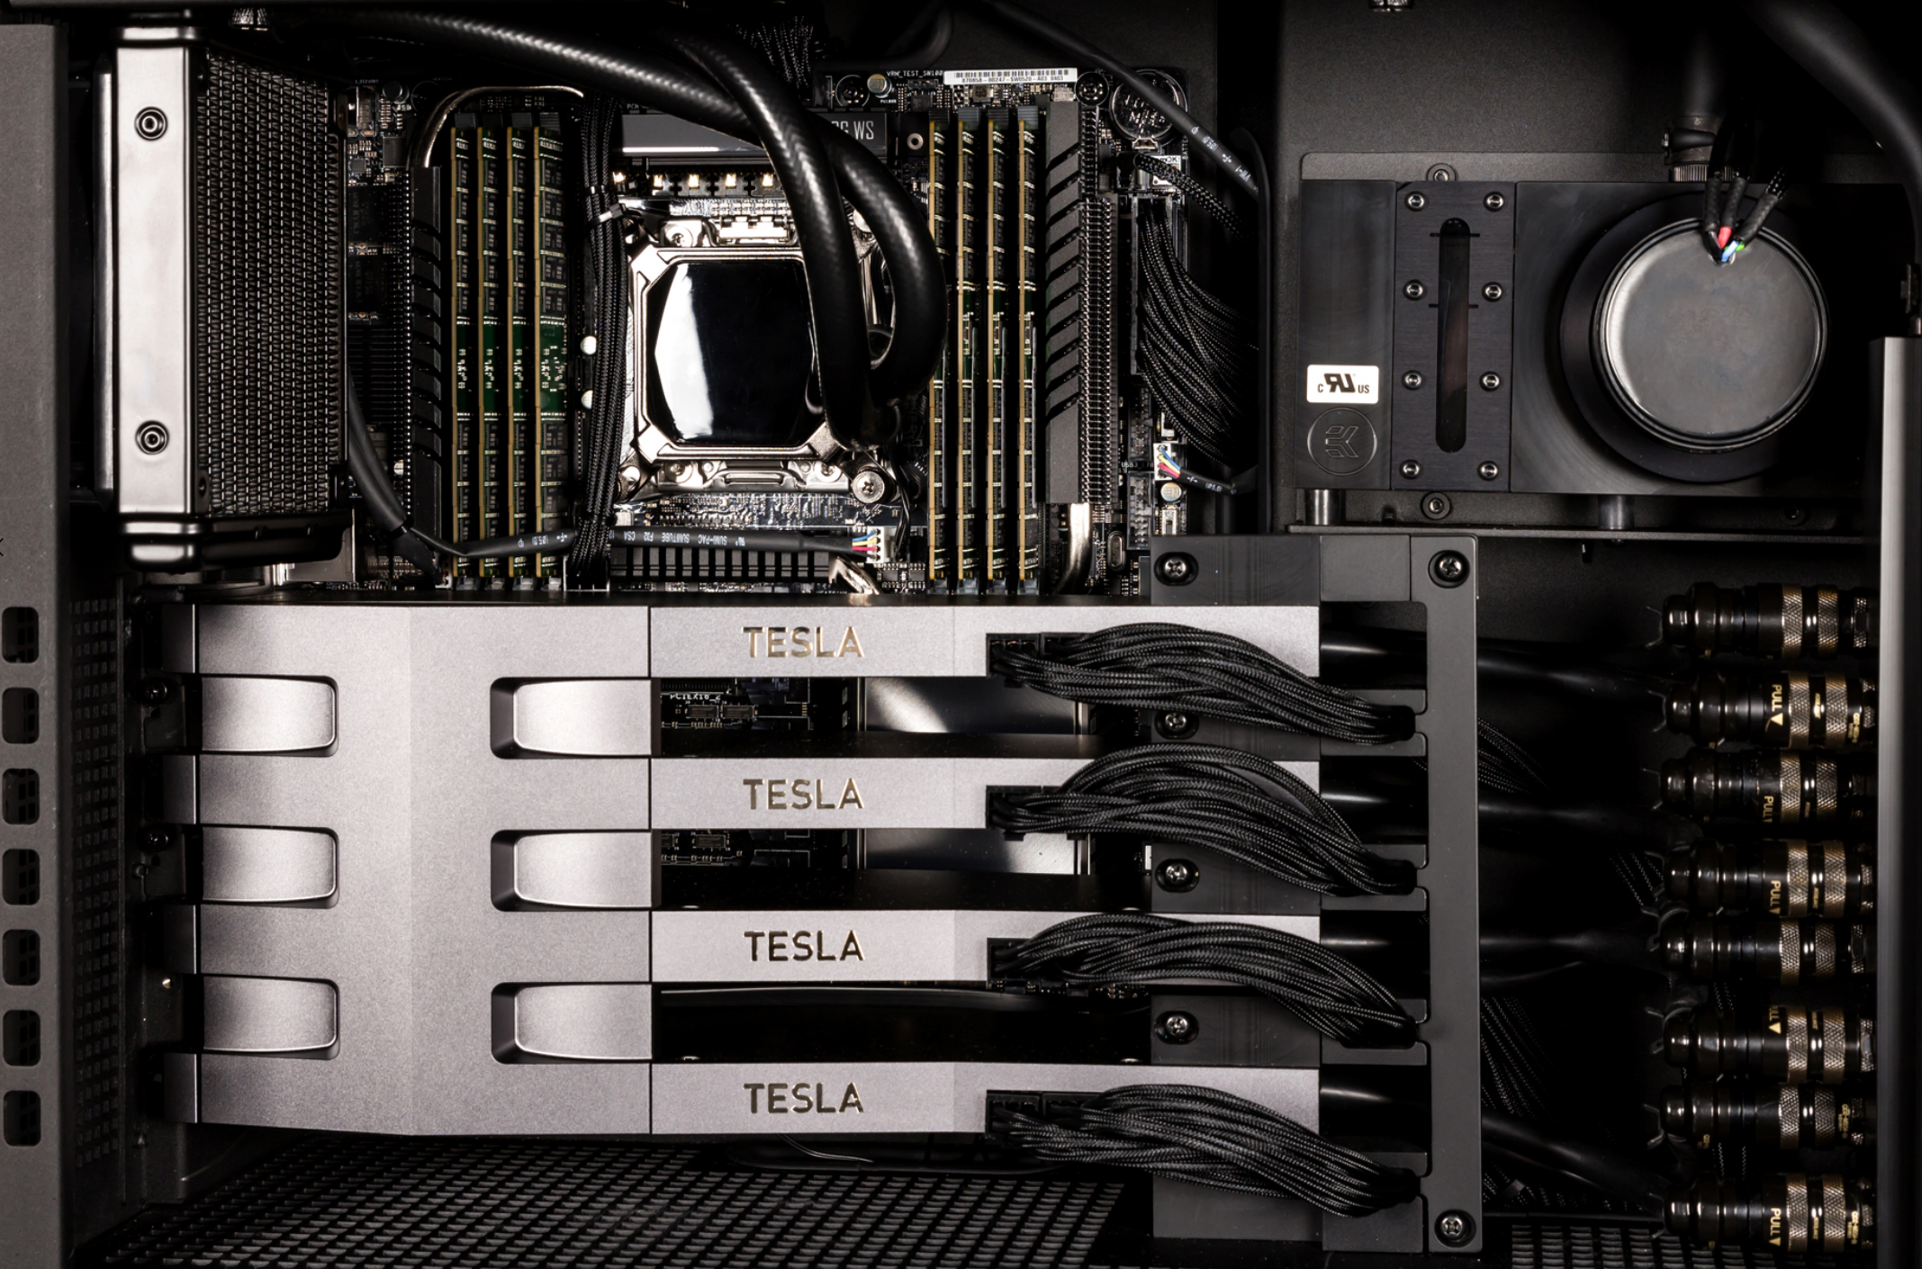
AI Jumpstart Cluster
The AI Jumpstart Cluster
7 state-of-the-art NVIDIA DGX-A100’s, each capable of delivering 5 petaflops for deep learning applications
14 nodes of AMD CPU/GPU heterogeneous computing, with 8 MI-50 GPUs, each rated at 26.5 TFLOPs for FP16, and 13.3 TFLOPS for FP32
Includes a large memory node (3TB of DDR4 RDRAM)
The Cluster will also be well integrated with the DARPA 5G Colosseum Simulator System at the Burlington Innovation Campus

