Slide 1
Connectivity Begins at Home
April 19th, 2023
BLU.org
Bob Frankston / https://Frankston.com

Slide 2
Initial Design point – Mid 90s X10
Original version from the 1990s
VB ➔ C#
X10 ➔ Insteon ➔ …
JSON Messaging
Shoehorned in Webapp & Smarthome
Problem
Legacy silting
TypeScript client but C# server
IIS Dependencies

Slide 3
The Big Rewrite: August 2022
TypeScript
Sketched out an outline and quickly become “production quality”
Integrate some of the tools and shims I had
Leverage from common language
Easy to share code as libraries, processes or whatever
Also built other tools
Certificate handling
Much more use of http(s)
Freedom from IIS – even in C#
And help from ChatGPT!

Slide 4
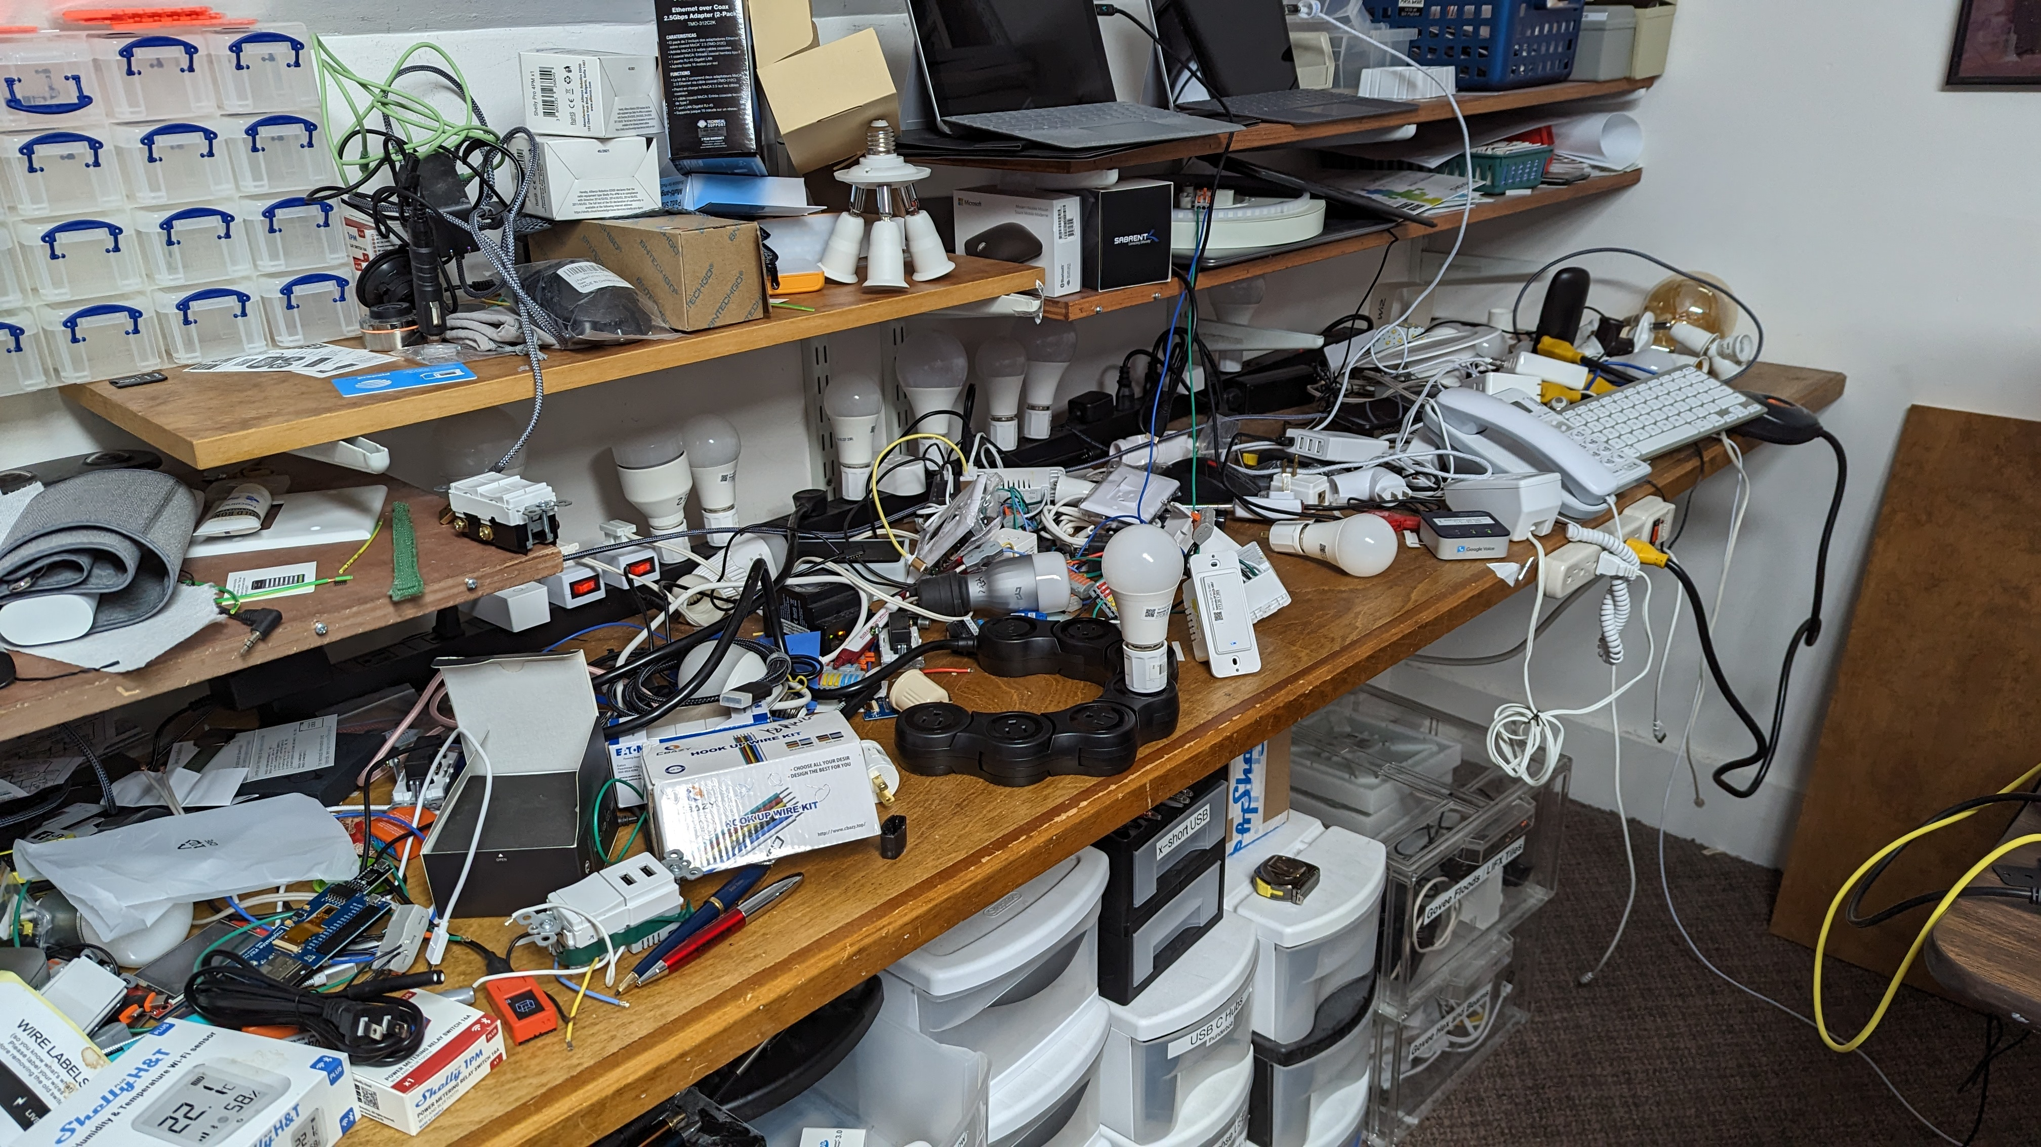
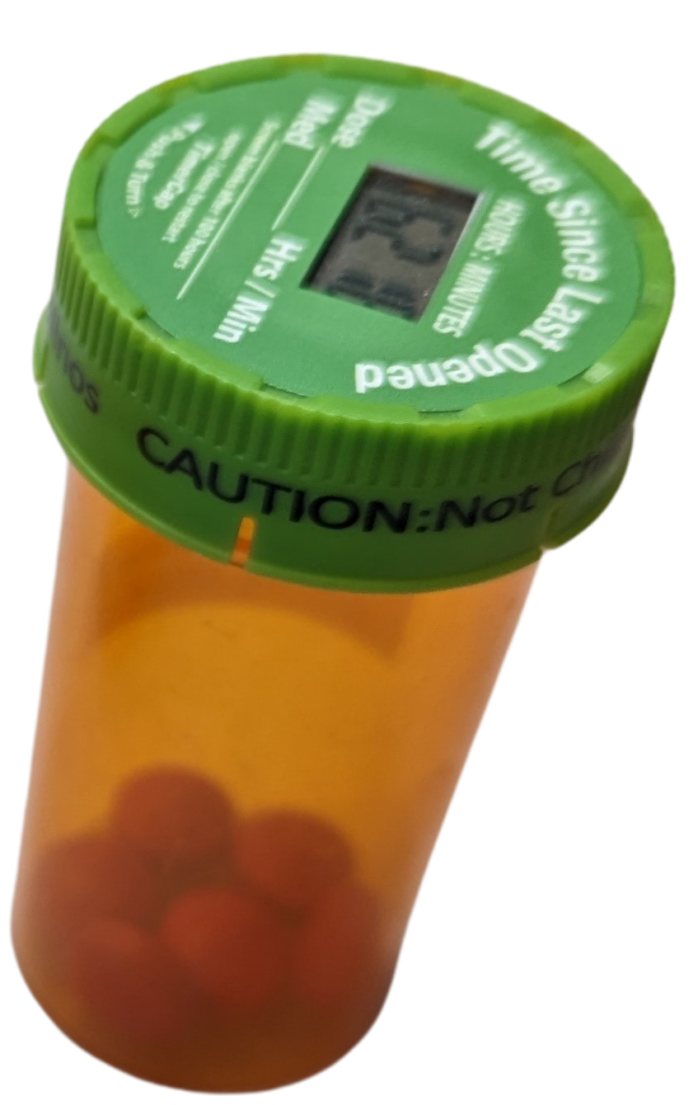
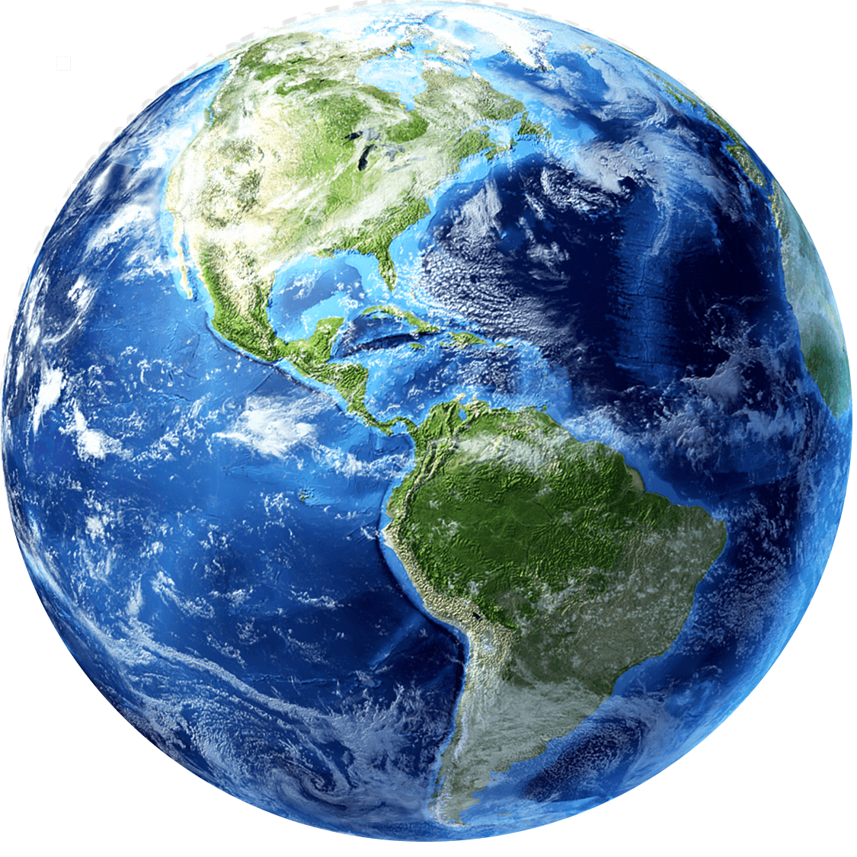
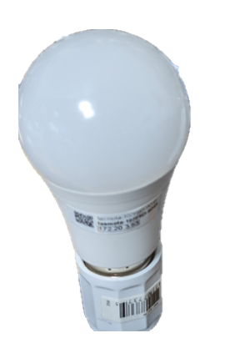
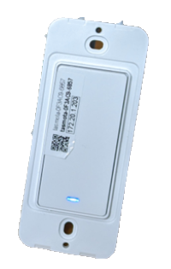
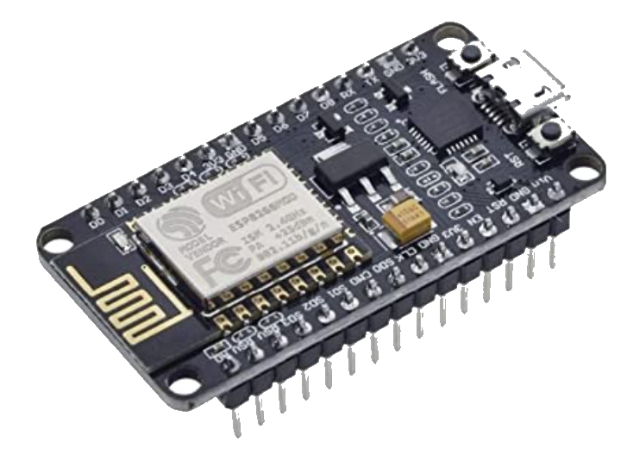
“Connected Anywhere in the World
Notes:
Home networking and individuals – TLB, Tasmota, M

Slide 5
Key design points
Learn by doing
System is live, and failures have consequences
Need it to work even if I’m not home
Resilience and idempotence
Try to avoid single points of dependency
Primary paths and secondary ones
IP (UDP, HTTP(S)), Hubitat, HomeAssistant, Shim, MQTT
Also, multiple facets

Slide 6
Cooperating Elements
Main Engine
Main Engine
Interprets rules as rules and also as collections
Runs on main desktop
Webapp / PWA
Runs anywhere there is a current browser
Depends on https
Shims for HTTPS⬄UDP and other platforms

Slide 7
Cooperating Elements
Bridges
Smarthome ➔ Hubitat
HomeAssistant
Web/HTTP(S) devices
Shelly.Cloud
Tasmota
ESPHome (HomeAssistant)
UDP: LIFX, Wiz, Govee
UPnP*: YeeLight (小米)
Others …

Slide 8
Incomplete … a work-in-progress
Still focused on
On/Off, Lights and levels
Grouping and simple rules
Scripting API / JSON
Other functions are still siloed apps
Color and Temperature
Special hacks like scenes
Cameras
Special effects

Slide 9
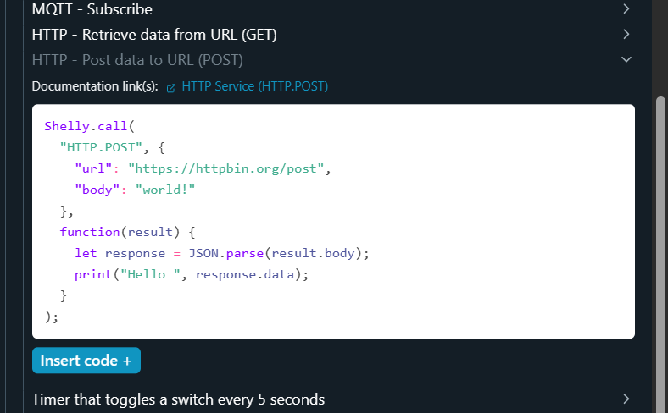
Peeking ahead
Software Everywhere
AI / ChatGPT et al.
Matter (Hardware-centric)
Public Packet Infrastructure!
This approach write-large

Slide 10
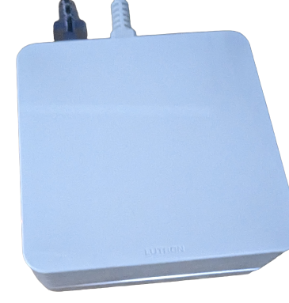
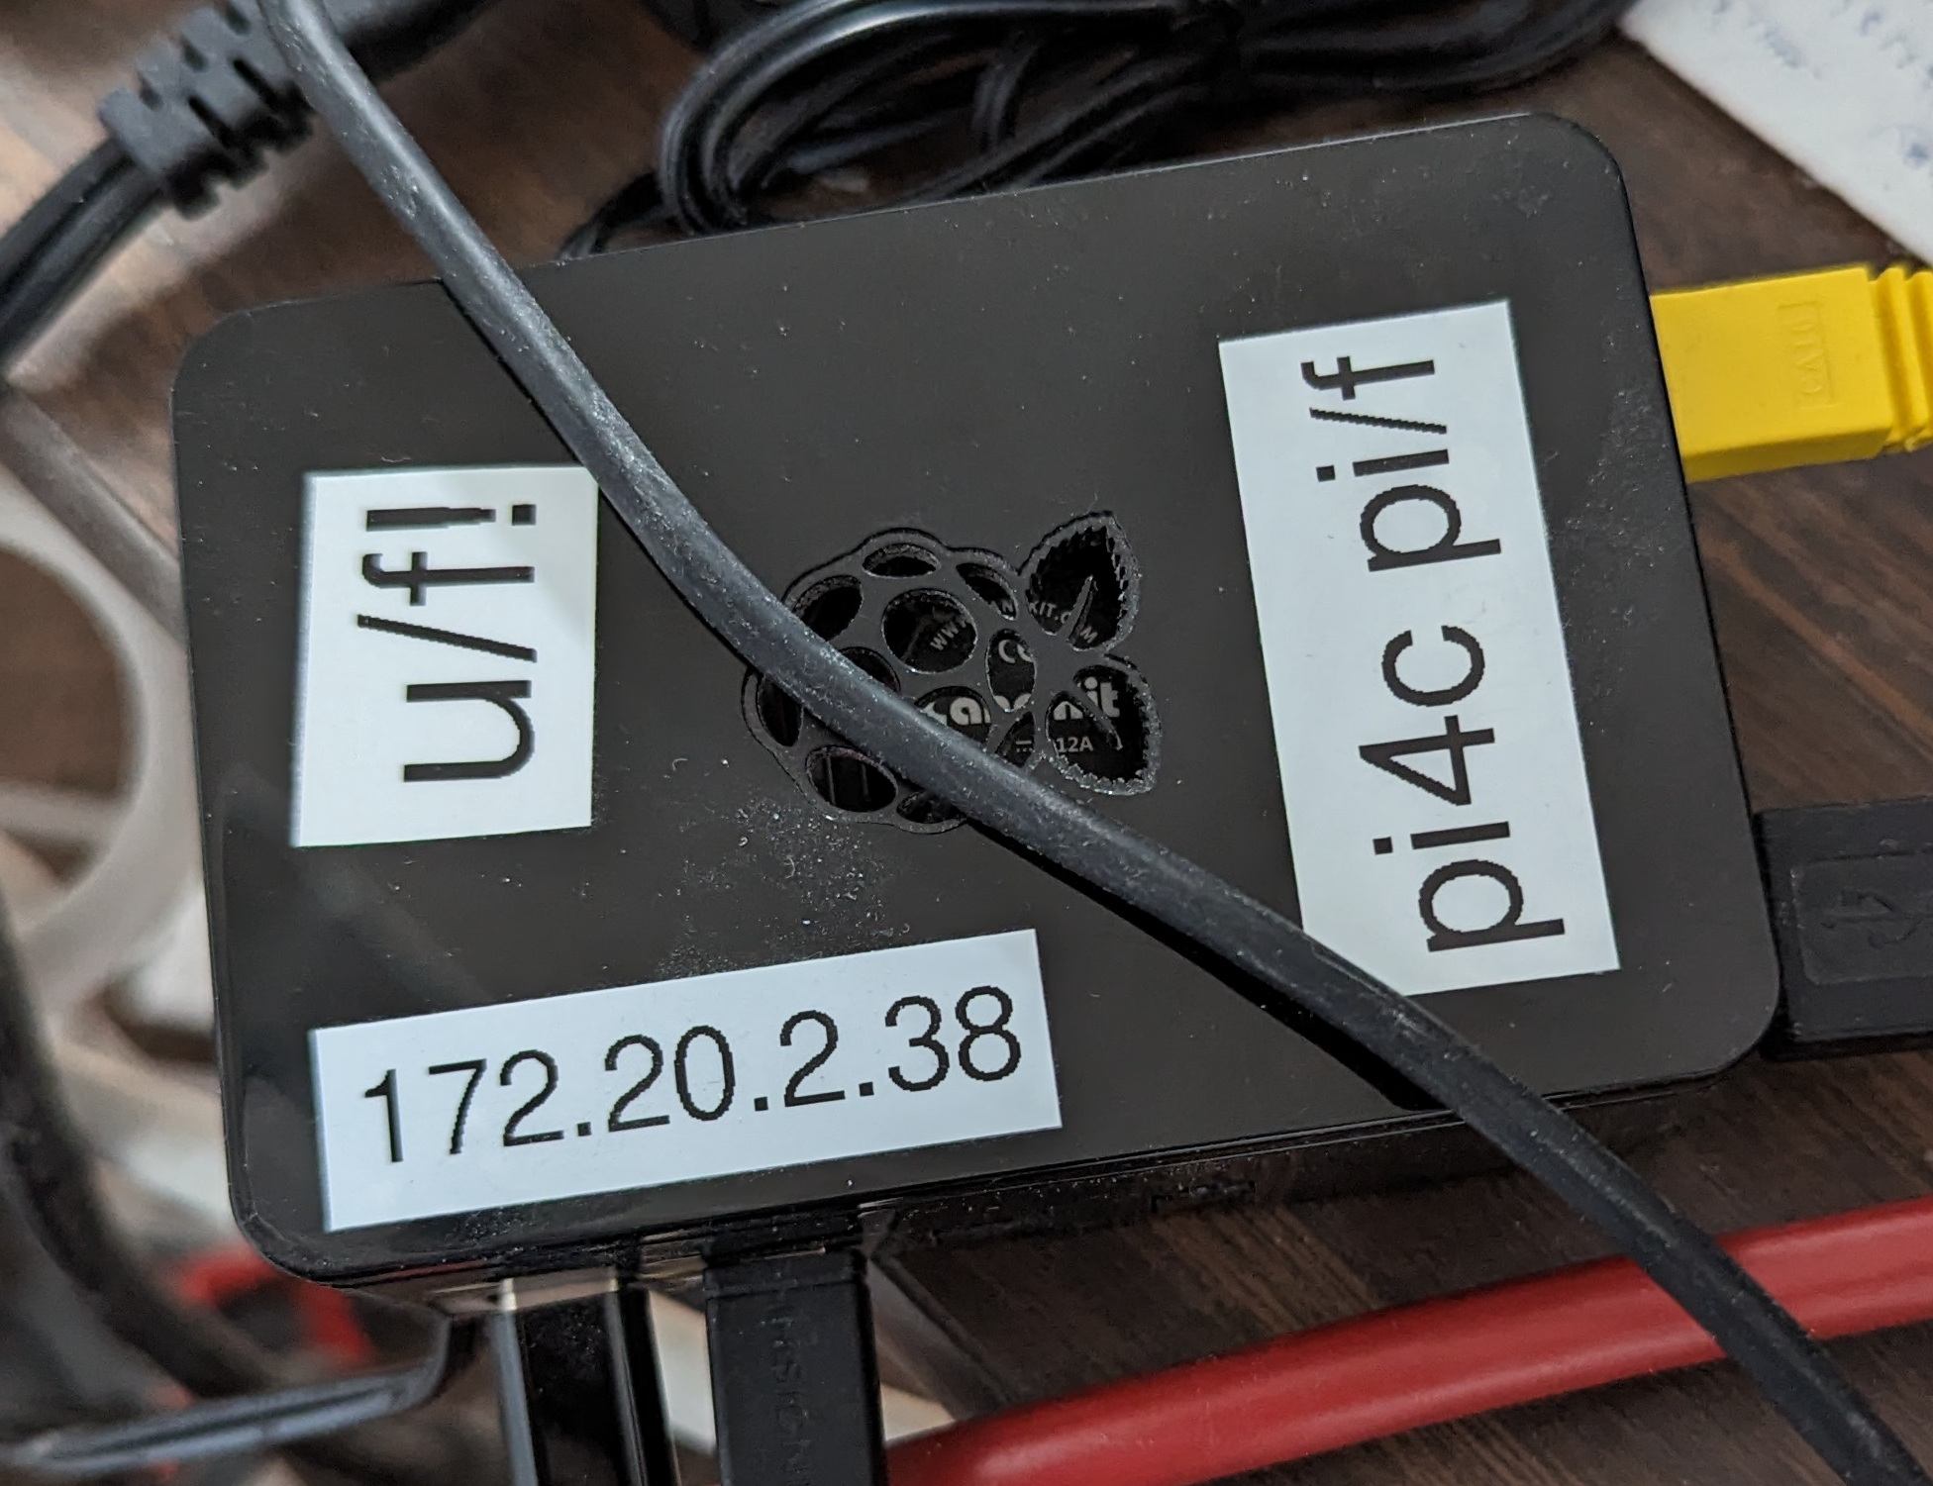
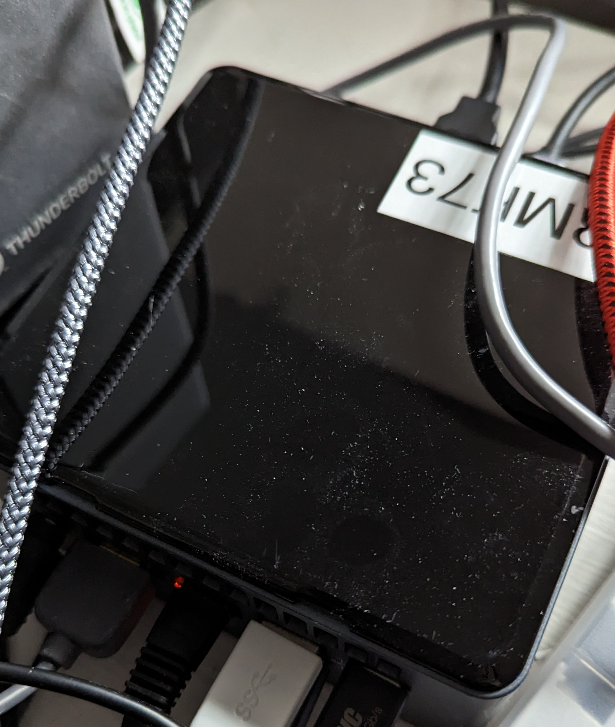
A (Extreme) Journey
Casetta
HomeAssistant
MQTT Broker
NUC
MQTT Handler
HTTPS
Main Handler
Rule Engine
Handlers

Slide 11
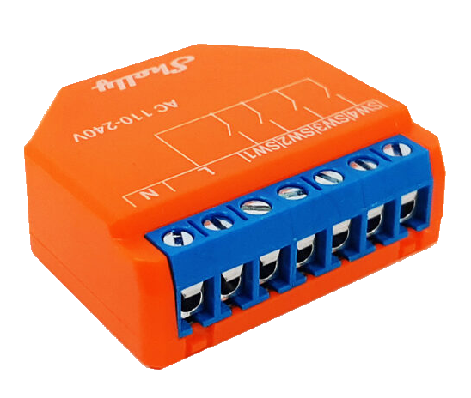
Multiple Paths w/Direct Actions
JavaScript Engine
Webapp ➔ Direct HTTPS
Webapp ➔ Shim HTTPS
Webapp ⬄ Websockets

Slide 12
Naming ➔ Binding
Old school
Name a device “KSink3” in the device itself
New Approach
Keep a name like kauf-bulb-b6359c.aaz.lt
And also, light.kauf_bulb_5
Families ➔ Paths and preferences
DNS for binding
https://rmf.vc/ForeverURLs

Slide 13
Living the Beta Life
Repurpose Internet protocols
NAT gives me freedom
Local First!
DHCP as DNS to provide local addresses (shadowing)
DHCP vs mDNS
Bridges and Shims to the wider world
Possible thanks to best efforts connectivity
Rely on (undocumented) Ubiquiti APIs for mapping and discovery
https://rmf.vc/IEEEBetaLife

Slide 14
HTTP, WS, MQTT (S) – JSON Bundles
Very flexible
Common format over any path
Not strict restful
Shifting to “S” (HTTPS, WSS …)
Manage my own certificates via DNS!
Choose certs dynamically – thanks ChatGPT
(Also now use it for my site)
Certs are still a challenge for devices
Support and renewal

Slide 15
Lies I tell children and everyone else
Wi-Fi is terrible – just better than alternatives
Often fails perversely
Main devices are not resilient (Wiz)
PWAs
Keep exiting – Still need more work on my part
Need more low-level access
HTTPS restriction is paint
USB is beyond terrible
Lots more tooling needed
Growing To-Do list

Slide 16
Single Points of Failure
Wi-Fi
PWA – work in progress
Access Points, DHCP, DNS
MQTT
HomeAssistant, Hubitat

Slide 17
Speaking of tooling
Mostly Typescript + my own SQL Library
SQL Server
JSON Files
Ubiquiti and other APIs
Tools
SwapBulb (or devices) to rebind relationships to new device
AddOne command (also auto via MQTT)
IPLabels
Etc.

Slide 18
What’s the Matter: NBT
Old school by hardware people (Z!)
Perimeter security for Thread
Bit twiddling vs. JSON
Interfaces designed by committees rather than implementors
Will use it just like for Zigbee etc. (same Silicon Labs)

Slide 19
Partial To-Do list
https://Frankston.com
BLU2023@bob.ma
Questions?

